Slide 1
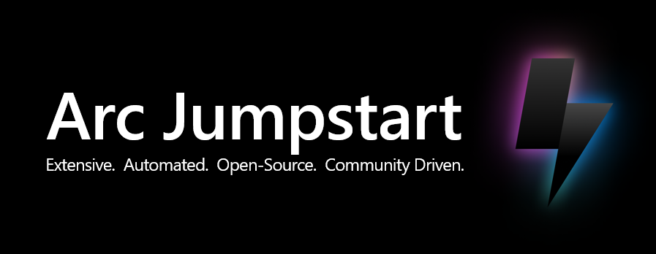
aka.ms/ArcJumpstart

Slide 2
Arc Jumpstart mission
The Arc Jumpstart is designed to provide a “zero to hero” experience so you can start working with Azure Arc right away!
The Jumpstart provides step-by-step guides for independent Azure Arc scenarios that incorporate as much automation as possible, detailed screenshots and code samples, and a rich and comprehensive experience while getting started with the Azure Arc platform.
Our mission is for you to have a working Azure Arc environment spun-up in no time so the user can focus on the core values of the platform, regardless of where your infrastructure may be, either on-premises or in the cloud.

Slide 3
Arc Jumpstart – Why it was created?
Azure Arc is unique, encompasses many aspects of Azure management
Documentation of other platforms/clouds architecture/implementation non-existent
Self sufficient scale enablement accelerator for Microsoft sellers and partners
Community enabler
Simplified product implementation experience relative to Microsoft Docs (MSLearn)

Slide 4


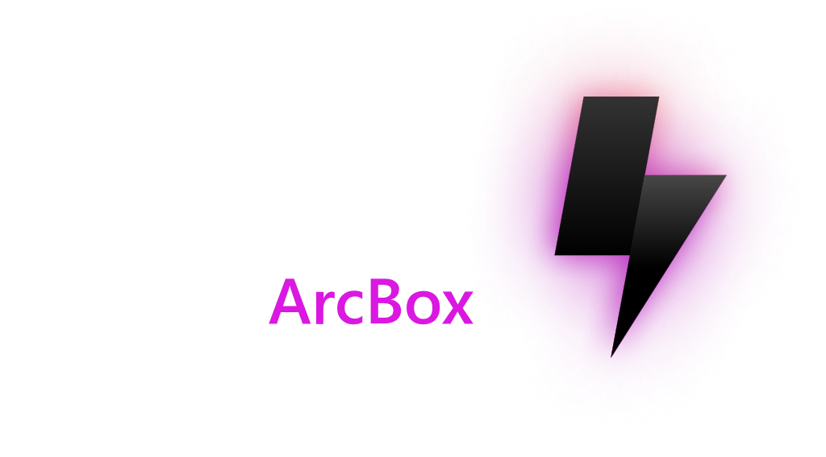



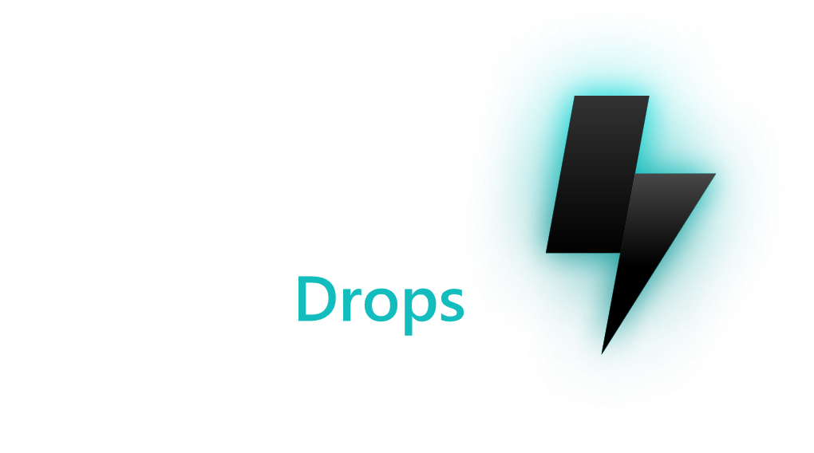
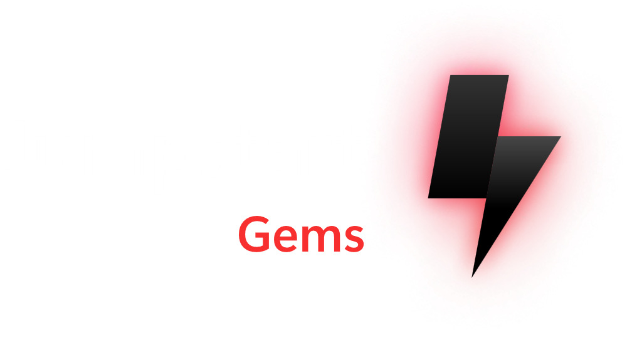
Jumpstart engineering principles
User never fail mentality
Where possible, automate all things
Modular code
Detail-Oriented
Open-Source
Public Preview and GA product coverage
Continuous product synergy
https://aka.ms/JumpstartMission

Slide 5













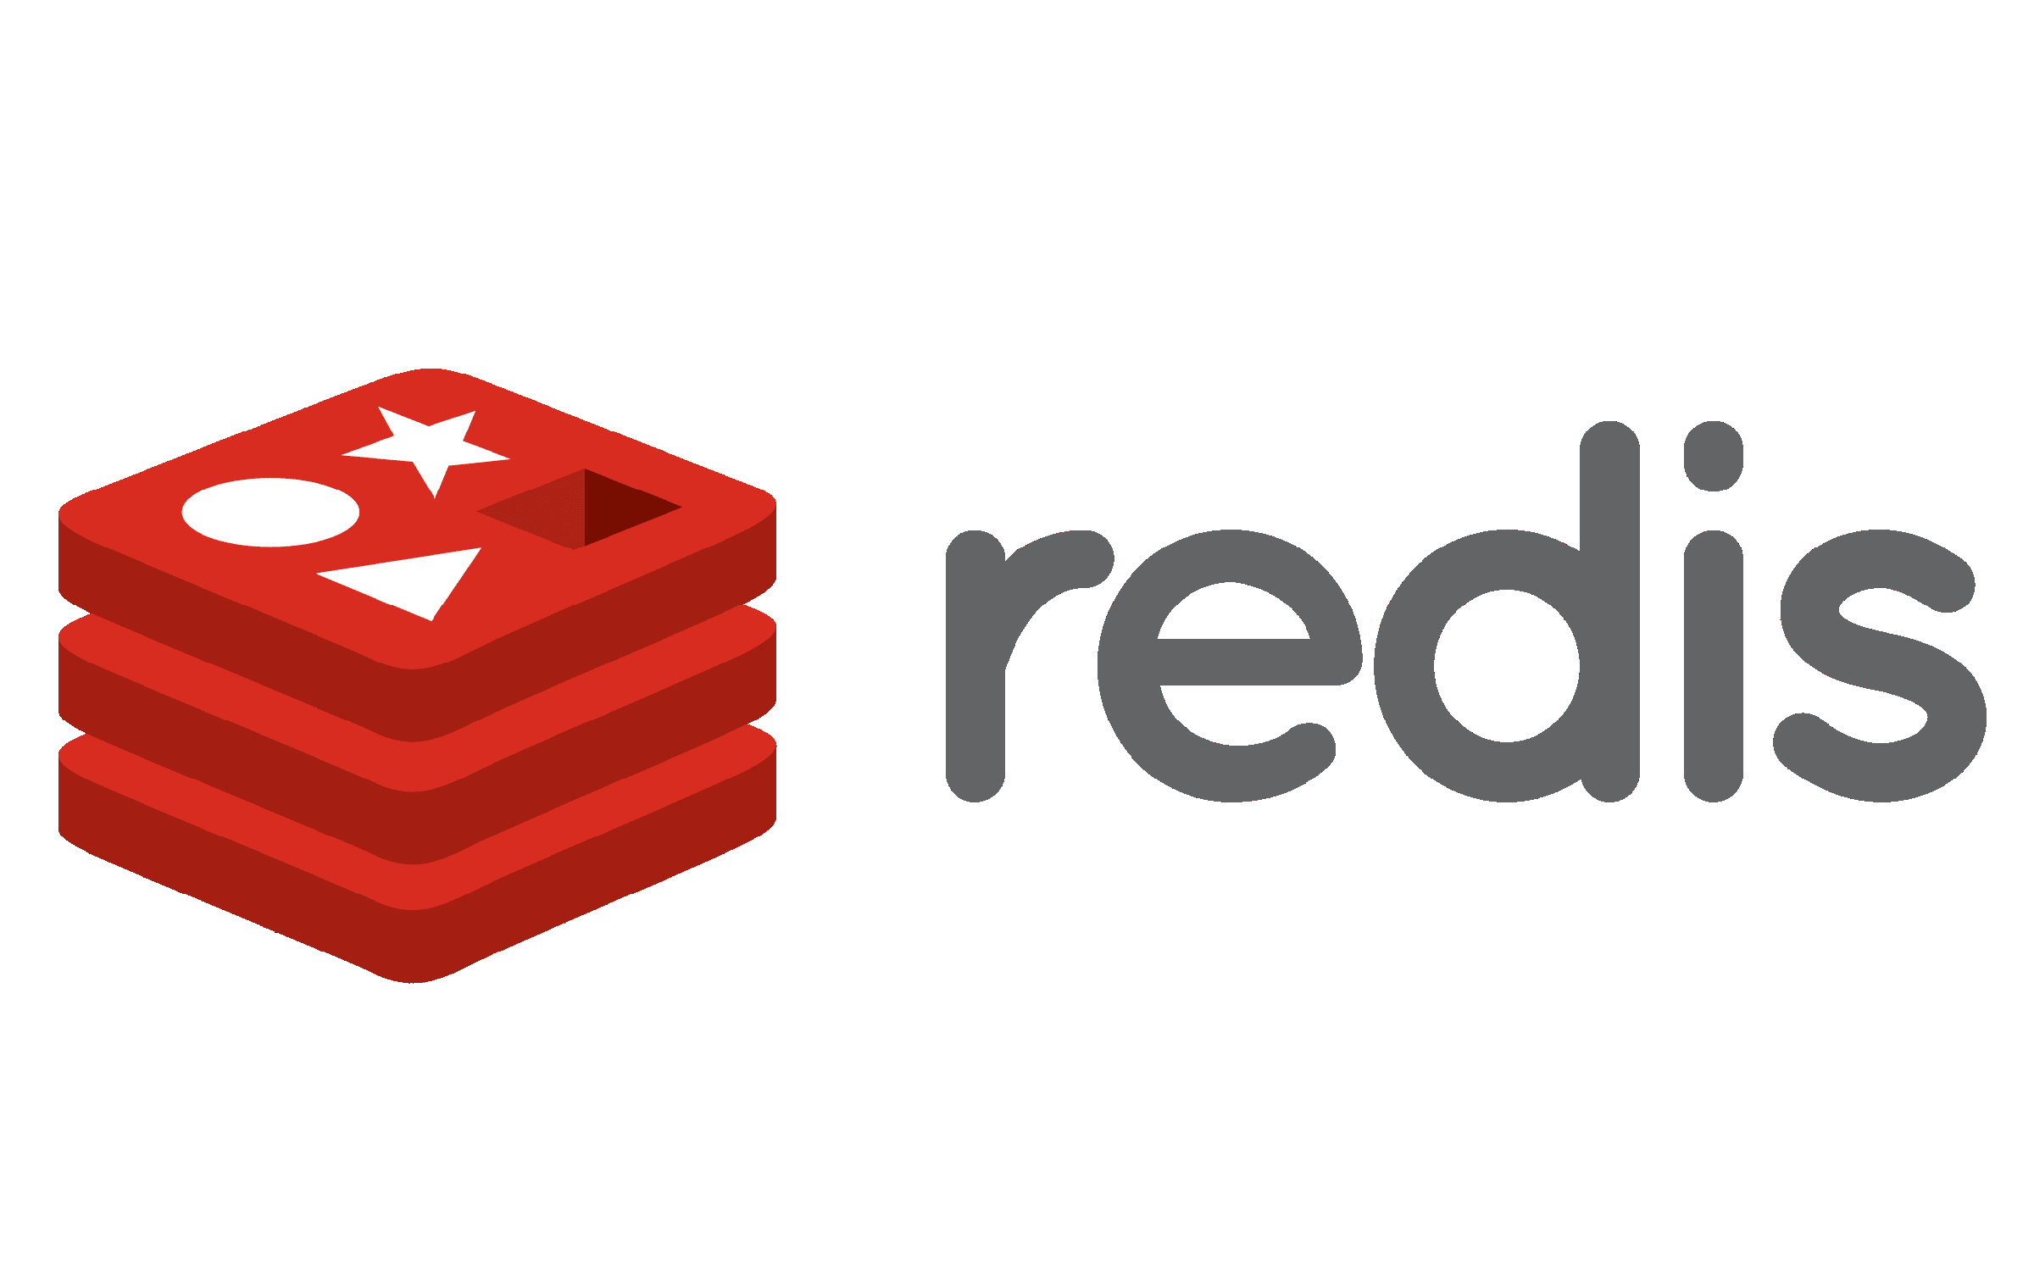













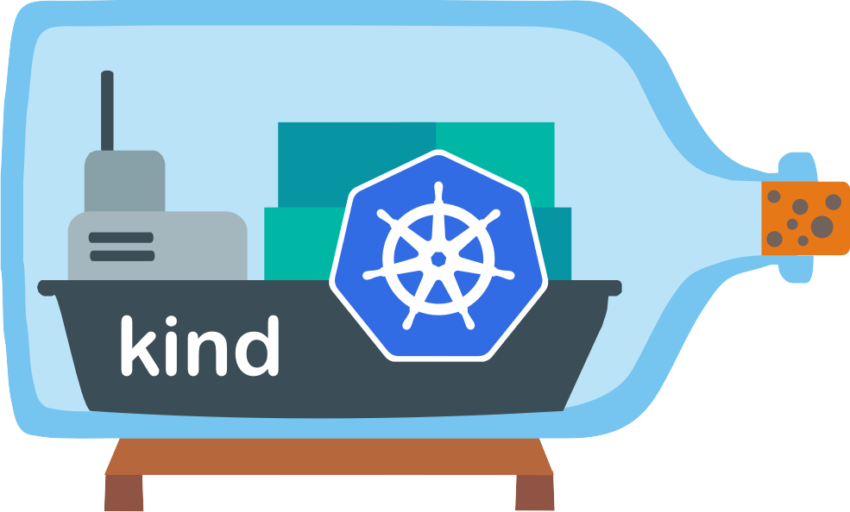



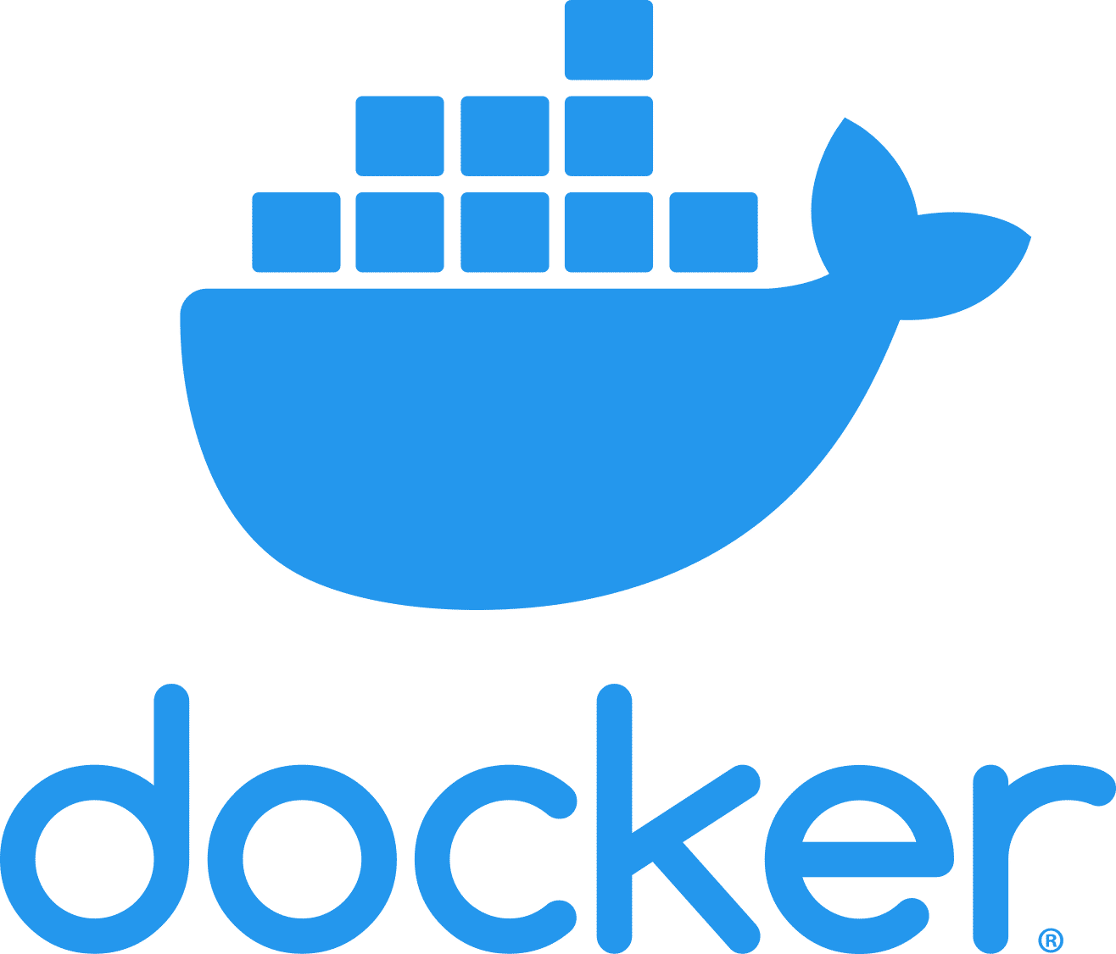



Arc Jumpstart – Committed to open-source

Slide 6
Fully automated Azure Arc sandbox

Slide 7
Arc Jumpstart – ArcBox use cases
Sandbox environment for getting hands-on with Azure Arc
Accelerator for Proof-of-concepts or pilots
Used as the reference implementing for Azure Arc Landing Zone Accelerators
Training tool for Azure Arc skills development
Demo environment for customer presentations or events
Rapid integration testing platform

Slide 8
Arc Jumpstart – ArcBox design principals
A dedicated sandbox environment for testing GA or public preview capabilities of Azure Arc. No private preview features are included
Support as many deployment options as possible – Azure portal, ARM templates, Bicep, Terraform, PowerShell, bash and more
Self-contained in Azure with no dependencies on having an on-premises or multi-cloud environment
Comprehensive, Repeatable, Reliable
Accurately represent “real” scenarios
Re-use Azure Arc Jumpstart scenarios code where possible

Slide 9
Arc Jumpstart – ArcBox flavors
ArcBox comes in multiple “flavors”, or configurations, which can be selected to best suit your needs. Currently, the available flavors are:
ArcBox for IT Pros ArcBox for IT Pros focuses specifically on Arc-enabled servers and SQL Server enabled by Azure Arc functionality.
ArcBox for DevOps ArcBox for DevOps focuses specifically on Azure Arc-enabled Kubernetes and the experience for DevOps engineers.
ArcBox for DataOps ArcBox for DataOps focuses specifically on SQL Server enabled by Azure Arc and Arc-enabled SQL Managed Instance.

Slide 10
















Arc Jumpstart – ArcBox ITPros architecture
Deployed via ARM Template or Bicep
ArcBox resource group
ArcBox Workbook
Azure Monitor
Azure Policy
Azure Log Analytics
Microsoft Defender for Cloud (Servers and SQL)
Microsoft Sentinel
Azure Update Manager
Migration assessment
Best practices assessment
ArcBox-SQL
Arc-enabled server and SQL server
ArcBox-Win2K22 Arc-enabled server
ArcBox-Win2K25 Arc-enabled server
ArcBox-Ubuntu-01
Arc-enabled server
ArcBox-Ubuntu-02
Arc-enabled server
ArcBox-SQL
Nested Hyper-V VM
ArcBox-Win2K22 Nested Hyper-V VM
ArcBox-Win2K25 Nested Hyper-V VM
ArcBox-Ubuntu-01
Nested Hyper-V VM
ArcBox-Ubuntu-02
Nested Hyper-V VM
ArcBox-Client
Windows Server 2025 Client VM (deployed in Azure, nested virtualization enabled)
ArcBox Azure Virtual Network

Slide 11



Arc Jumpstart – ArcBox ITPros ARM/Bicep deployment automation flow
Jumpstart ArcBox
template
Jumpstart user
ARM / Bicep deployment
Client VM
template
Azure storage account template
Management artifacts template
ArcBox resource group
ArcBox Client Azure VM
ArcBox Azure
storage account
ArcBox management and operations artifacts
“Servers” logon PowerShell scripts
Azure Policy assignments template
Arc-enabled servers and SQL onboarding scripts
SQL Best Practices Assessment
ArcBox Azure Monitor
workbook template
SQL Server Migration Assessment
Azure Log Analytics workspace and
Update Management enablement solution for Log Analytics
PowerShell DSC configuration
Microsoft Defender for SQL
WinGet Packages
Defender for SQL data collection rules
Hyper-V host and VM setup
Defender for SQL threat simulation

Slide 12


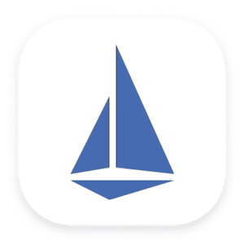



Arc Jumpstart – ArcBox DevOps architecture
Deployed via ARM Template or Bicep
ArcBox resource group
ArcBox Workbook
Azure Monitor
Azure Policy
Azure Log Analytics
Microsoft Defender for Containers
GitOps Configurations
ArcBox-Client
Windows Server 2025 Client Azure virtual machine
Ubuntu Azure virtual machine
Ubuntu Azure virtual machine
Rancher k3s three-node cluster (pre-configured)
Rancher k3s three-node cluster (vanilla)
Arc-enabled Kubernetes cluster
Arc-enabled Kubernetes cluster
DevOps tools
Istio Service Mesh
Istio Service Mesh
Traffic
splitting
Traffic
splitting
Sample application
Sample application
ArcBox Azure Virtual Network

Slide 13
Arc Jumpstart – ArcBox DevOps ARM/Bicep deployment automation flow
Jumpstart ArcBox
template
Jumpstart user
ARM / Bicep deployment
Client VM
template
K3s
template
Azure storage account template
Management artifacts template
ArcBox resource group
ArcBox Client Azure VM
Rancher K3s Azure VM three-node workload cluster (pre-configured)
Rancher K3s Azure VM three-node workload cluster
(vanilla)
ArcBox Azure
storage account
ArcBox management and operations artifacts
“DevOps” logon PowerShell scripts
Azure Policy assignments template
Azure Arc-enabled Kubernetes
cluster extensions scripts
Arc-enabled Kubernetes cluster resources
Azure Log Analytics workspace and
Update Management enablement solution for Log Analytics
Jumpstart sample apps deployment logic scripts
ArcBox Azure Monitor
workbook template
PowerShell DSC configuration
WinGet Packages
Hyper-V host and VM setup

Slide 14

Arc Jumpstart – ArcBox DevOps “Bookstore” Service Mesh architecture
v1 web traffic redirection based on Traffic Split policy
“Bookstore” service v1
Book purchase transaction recorded in database
“Book Buyer” service
Traffic Split policy enforced via GitOps process
“Book Warehouse” service
“Bookstore” service v2
v2 web traffic redirection based on Traffic Split policy
Book purchase transaction recorded in database

Slide 15
Arc Jumpstart – ArcBox DevOps “Bookstore” Service Mesh Interface (SMI) Traffic Split (Blue/Green)
v1 in production
v1 in production / v2 integration tests
v2 in production
100% web traffic
“Bookstore” service v1
75% web traffic
“Bookstore” service v1
0% web traffic
“Bookstore” service v1
“Book Buyer” service
“Book Buyer” service
“Book Buyer” service
“Bookstore” service v2
“Bookstore” service v2
“Bookstore” service v2
0% web traffic
25% web traffic
100% web traffic

Slide 16










Arc Jumpstart – ArcBox DataOps architecture
Deployed via ARM Template or Bicep
ArcBox resource group
ArcBox Workbook
Azure Monitor
Azure Policy
Azure Log Analytics
Azure Tags
Grafana
Microsoft Defender for Cloud (Servers and SQL)
Migration assessment
Best practices assessment
ArcBox-Client
Azure VM installed with DBA tools
Primary site
DR site
ArcBox-SQL
Arc-enabled server and SQL server
Primary Azure Kubernetes Service (AKS) three-node cluster
Rancher k3s three-node cluster
DR Azure Kubernetes Service (AKS) three-node cluster
Arc-enabled Kubernetes cluster
Arc-enabled Kubernetes cluster
Arc-enabled Kubernetes cluster
Sample applications
Sample applications
Sample applications
App database
App database
App database
ArcBox-SQL
Nested Hyper-V VM
Disaster recovery simulation
Arc Data Controller
Arc-enabled SQL Managed Instance
Arc Data Controller
Arc-enabled SQL Managed Instance
Arc Data Controller
Arc-enabled SQL Managed Instance
ArcBox-DC
Azure VM with local Active Directory and DNS
ArcBox-Client
Windows Server 2022 Client VM (deployed in Azure, nested virtualization enabled)
Virtual network peering
ArcBox Primary Azure Virtual Network
ArcBox DR Azure Virtual Network

Slide 17
Arc Jumpstart – ArcBox DataOps ARM/Bicep deployment automation flow
Jumpstart ArcBox
template
Jumpstart user
ARM / Bicep deployment
Client VM
template
K3s
template
AKS
template
Azure storage account template
Management artifacts template
ArcBox resource group
ArcBox Client Azure VM
Rancher K3s Azure VM three-node workload cluster
Two 3-node AKS Clusters
(Primary / DR)
ArcBox Azure
storage account
ArcBox management and operations artifacts
“DataOps” logon PowerShell scripts
Azure Policy assignments template
Arc-enabled servers and SQL onboarding scripts
SQL Best Practices Assessment
Arc-enabled Kubernetes cluster resources
ArcBox Azure Monitor
workbook template
SQL Server Migration Assessment
Azure Log Analytics workspace and
Update Management enablement solution for Log Analytics
PowerShell DSC configuration
Microsoft Defender for SQL
WinGet Packages
Defender for SQL data collection rules
Hyper-V host and VM setup
Defender for SQL threat simulation

Slide 18
Fully automated Azure Local sandbox

Slide 19
Arc Jumpstart – LocalBox Challenges and motivation
Numerous Azure Local lab guides at varying levels of completeness or quality
Lack of end-to-end automation to deploy Azure Local with integrated Azure Arc services
Need to provide partners and customers with a complete sandbox for testing and training
Need for faster times to test/POC without waiting for hardware procurement or other delays
Laying the ground for future Azure Local Landing Zone Accelerator

Slide 20
Arc Jumpstart – LocalBox use cases
Sandbox environment for getting hands-on with Azure Local without the need for physical hardware
Accelerator for Proof-of-concepts or pilots
Training tool for Azure Local and hybrid Arc skills development
Demo environment for customer presentations or events
Rapid integration testing platform

Slide 21
Arc Jumpstart – LocalBox design principals
A dedicated sandbox environment for testing GA or public preview capabilities of Azure Arc. No private preview features are included.
Self-contained in Azure with no dependencies on having physical hardware
Showcase Azure Local integration with hybrid services and tools (Azure Arc and Windows Admin Center)
Comprehensive, Repeatable, Reliable
Modular flexibility and configuration for the user

Slide 22







Arc Jumpstart – LocalBox architecture
Azure Bicep template
LocalBox resource group
Azure Monitor
Azure Policy
Azure Log Analytics
Microsoft Defender for Cloud
Microsoft Entra ID
AKS workload cluster service principal role-based access
Azure Local VMs enabled by Azure Arc
AKS workload cluster, Arc-enabled
VM Image Gallery
Registered Azure Local instance resource in Azure
Arc Resource Bridge
Custom Location
jumpstart.local domain joined
Azure Local instance
LocalBoxCluster (Hyper-V virtual machine)
AzLMGMT Management plane (deployed as nested Hyper-V VM)
AzLHOST1 Azure Local machine (deployed as nested Hyper-V VM)
AzLHOST2 Azure Local machine (deployed as nested Hyper-V VM)
Hyper-V Host Windows Server 2025 Datacenter VM (deployed in Azure, nested virtualization enabled)
LocalBox Azure Virtual Network

Slide 23
Arc Jumpstart – LocalBox Bicep deployment automation flow
Jumpstart LocalBox
template
Jumpstart user
Azure Bicep template deployment
ClientVM
template
Network template
Azure storage account template
Management artifacts template
LocalBox resource group
LocalBox Client Azure VM
Azure Virtual Network
LocalBox Azure
storage account
LocalBox management & operations artifacts
Client logon PowerShell scripts
Build Azure Local instance script
Network Security Group
Azure Policy assignments template
Generate ARM template script
ARM cluster validation phase
Azure Bastion (optional)
Azure Log Analytics workspace
ARM cluster deploy phase

Slide 24


Arc Jumpstart – LocalBox Nested virtualization architecture
AzLMGMT
Nested Hyper-V hypervisor installed on nested Hyper-V virtual machine
Azure Local instance
AzLHOST1 Azure Local machine
Domain joined, nested Hyper-V virtual machine
JumpstartDC Domain Controller
Domain joined, nested Hyper-V virtual machine
AzLHOST2 Azure Local machine
Domain joined, nested Hyper-V virtual machine
VM-Router Remote Access Server
Nested Hyper-V virtual machine
LocalBox-Client
Hyper-V Host Windows Server 2025 Datacenter VM (deployed in Azure, nested virtualization enabled)

Slide 25
Jumpstart for Industries and application development velocity across cloud and edge

Slide 26

Arc Jumpstart – What is “Agora”?
The word "agora" comes from the ancient Greek term for a public gathering place or assembly, and it has come to be used more broadly to refer to any place or forum where people come together for discussion or exchange.

Slide 27
Arc Jumpstart – Why Agora?
Demo is not enough; people need to try it by their selves.
Lack of hands-on artifacts that supports industries storytelling.
Random repositories are confusing and hard to maintain. One Jumpstart to rule them all.
Lack of quality “Spaghetti on the wall” mechanism and feedback loop to the product groups.
Need to meet users where they are.

Slide 28



Arc Jumpstart – Agora industrial vision
Retail
Manufacturing
Healthcare
And more…

Slide 29

Arc Jumpstart – Contoso Supermarket

Slide 30
Arc Jumpstart – Contoso Supermarket scenarios
Scenario | Contoso Supermarket service | Contoso Supermarket service or platform
Data pipeline and reporting across cloud and edge for store orders | Point of Sale (PoS) | Cosmos DB, Azure Data Explorer, OSS PostgreSQL, AKS Edge Essentials
Data pipeline and reporting across cloud and edge for sensor telemetry | Freezer Monitoring for Food Safety | IoT Hub, Azure Data Explorer, Mosquitto MQTT Broker, Prometheus, Grafana, AKS Edge Essentials
Enabling AI at the Edge & Software configurations rollout with basic GitOps flow | Managers Control Center | AKS Edge Essentials, GitOps (Flux), OSS PostgreSQL, Intel OpenVINO™ Inference Engine
Streamlining the Software Delivery Process using CI/CD | Point of Sale (PoS) | AKS, AKS Edge Essentials, Azure Arc, Flux, GitHub Actions, Azure Container Registry
Infrastructure observability for Kubernetes and Arc-enabled Kubernetes | Infrastructure | Arc-enabled Kubernetes, AKS, AKS Edge Essentials, Prometheus, Grafana
Infrastructure observability for Azure Arc-enabled servers using Azure Monitor | Infrastructure | Arc-enabled servers, Azure Monitor
Infrastructure security with Microsoft Defender for Servers | Infrastructure | Arc-enabled servers, Microsoft Defender for Cloud

Slide 31








Contoso Supermarket technology stack
Tools and operations
Contoso Supermarket applications stack
Point of Sale (PoS)
Checkout Queue Monitoring
Freezer Monitoring for Food Safety
Inner loop process
Microsoft Defender for Cloud
Azure Log Analytics
Prometheus and Grafana Observability stack
Outer loop process
Dev Containers
Azure Container Registry (ACR)
Azure Monitor
AKS Edge Essentials Arc-enabled Kubernetes
Azure Kubernetes Service (AKS)
IDE
GitHub Actions
Azure Automation
Azure Data Explorer (ADX)
Windows 11 IoT
Arc-enabled server
GitOps
Dashboards
Cost management
Azure IoT Hub
Azure Cosmos DB
Azure Compute, storage and network stack
Client interfaces

Slide 32


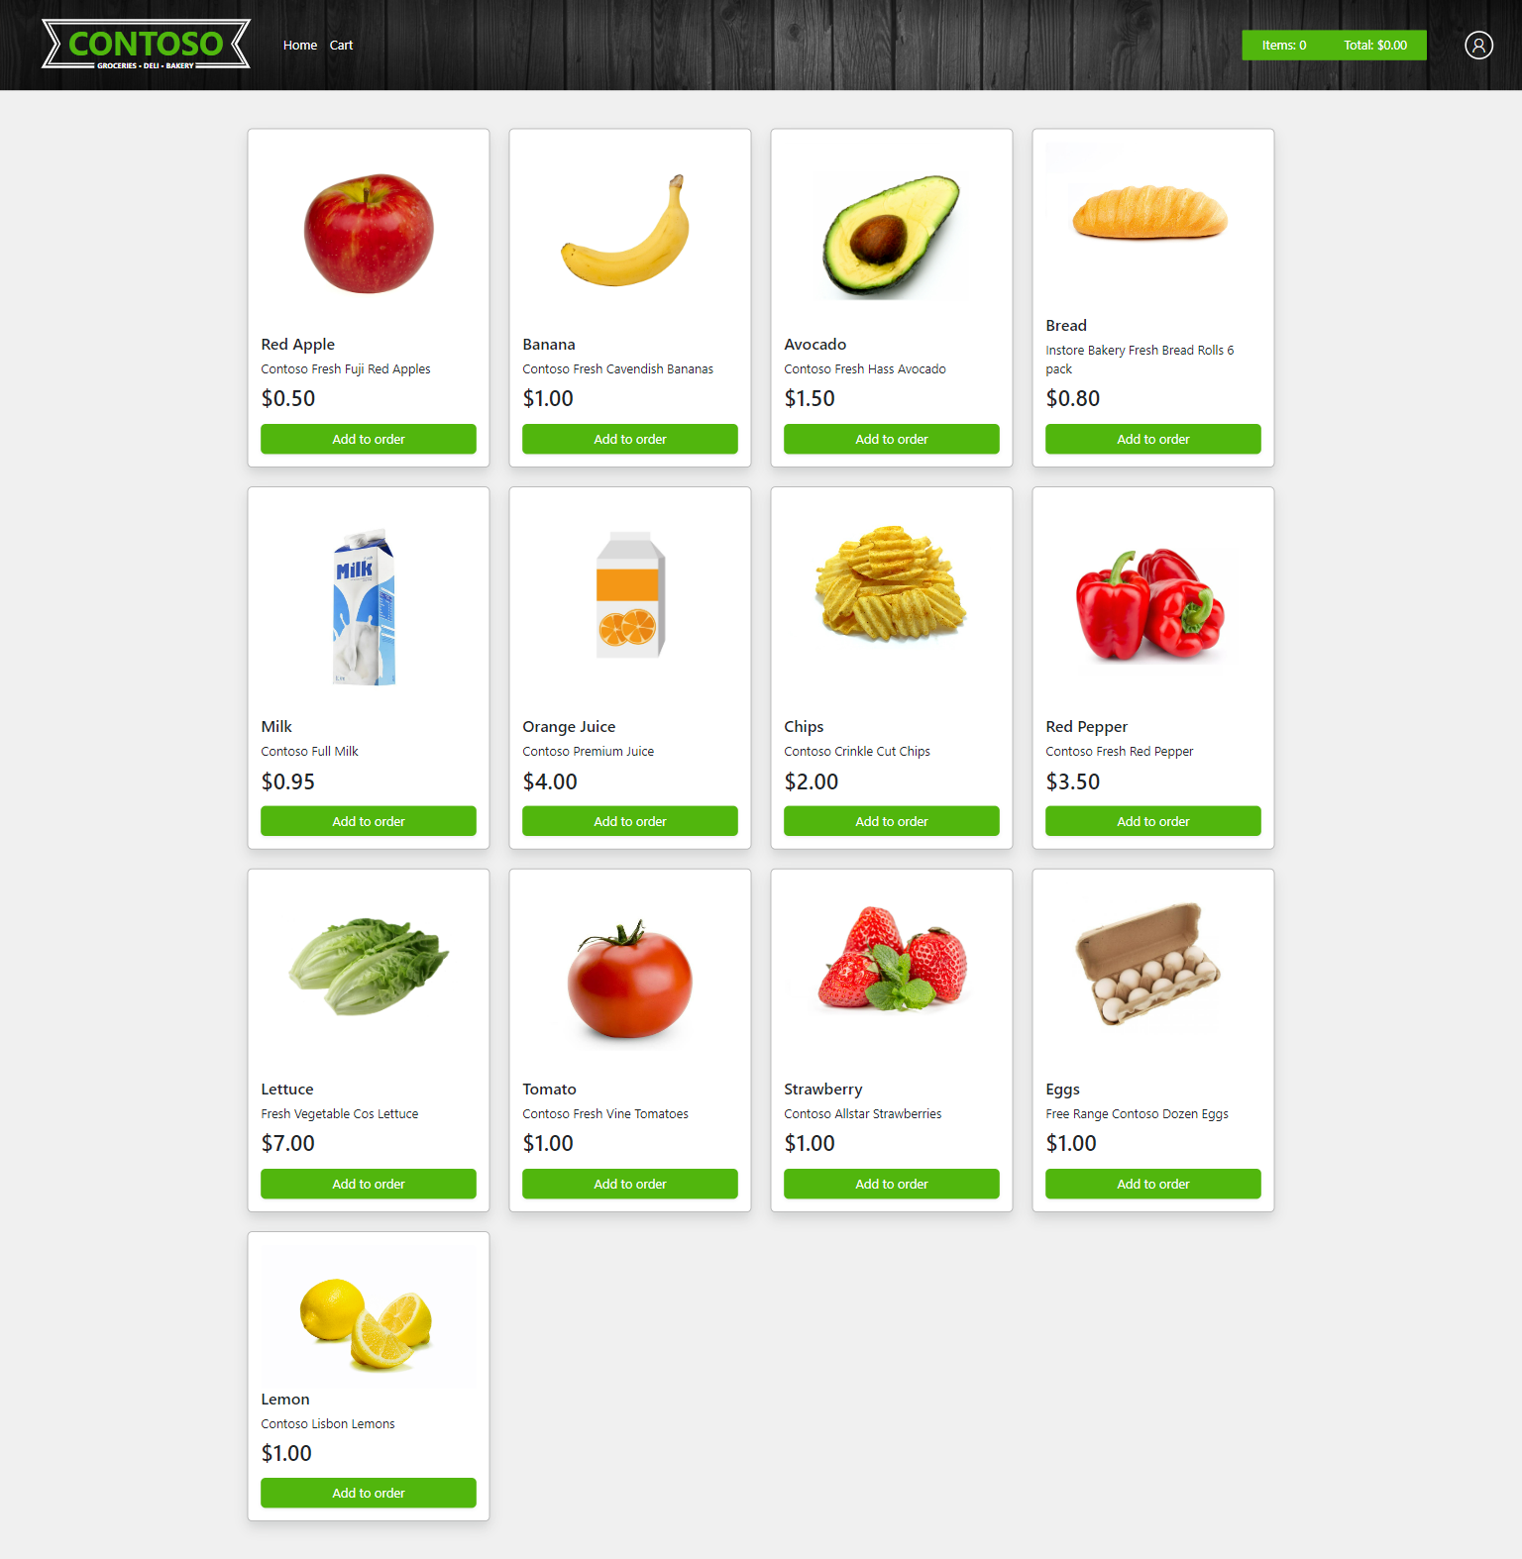


Contoso Supermarket – Point of Sale (PoS) service architecture
Customer select products and place order.
When the order is placed, an entry is generated in the local PostgresSQL DB containing the order date, the order details, and the store ID.
A cloud sync daemon is querying the Orders table every 2 minutes and creating a JSON document.
The JSON document is then pushed to Azure Cosmos DB for consolidation while allowing the store to operate locally.
Using Azure Data Explorer (ADX), the data is consolidated by timestamp and storeID.
Dashboard reports are created in ADX to analyze and render PoS order data.
Azure Data Explorer (ADX)
Azure Cosmos DB Orders Container
ADX Dashboards
timestamp and storeID consolidation
5
6
4
JSON: { orderId, orderDate, orderdetails, storeID, cloudSynced }
Store AKS Edge Essentials cluster (Arc-enabled)
1
Store Point of Sale (POS)
PSQL: INSERT INTO contoso.Orders (orderDate, orderDetails, storeID)
Local PostgreSQL database server
PSQL: SELECT FROM contoso.Orders where cloudSynced = 0
Cloud Sync daemon
2
3
Contoso Supermarket customer

Slide 33


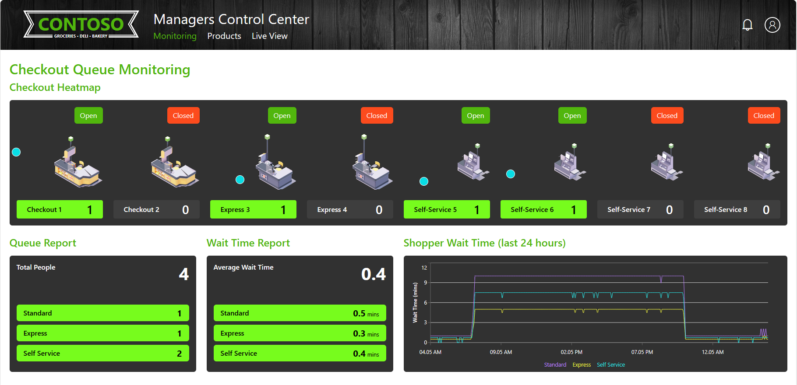

Contoso Supermarket – Checkout Queue Monitoring service architecture
Store cameras
“Checkout Queue Monitoring” frontend service – A web application that allows the monitoring of checkout queues, updates to products and a live camera feed view.
“Checkout Queue Monitoring” backend service – A background service that generates queue data, with a minimal API that powers the frontend service and interface with PostgreSQL database server.
PostgreSQL database server – Interact with the “Queue Monitoring” backend service and holds the service generated data.
“Checkout Queue Monitoring AI API” service – Provides an API for the Queue Monitoring frontend service to display a live camera feed view.
1
Store AKS Edge Essentials cluster (Arc-enabled)
Queue Monitoring AI API service
Local PostgreSQL database server
4
3
Queue Monitoring frontend service
Queue Monitoring backend service
1
2
Contoso Supermarket store manager

Slide 34
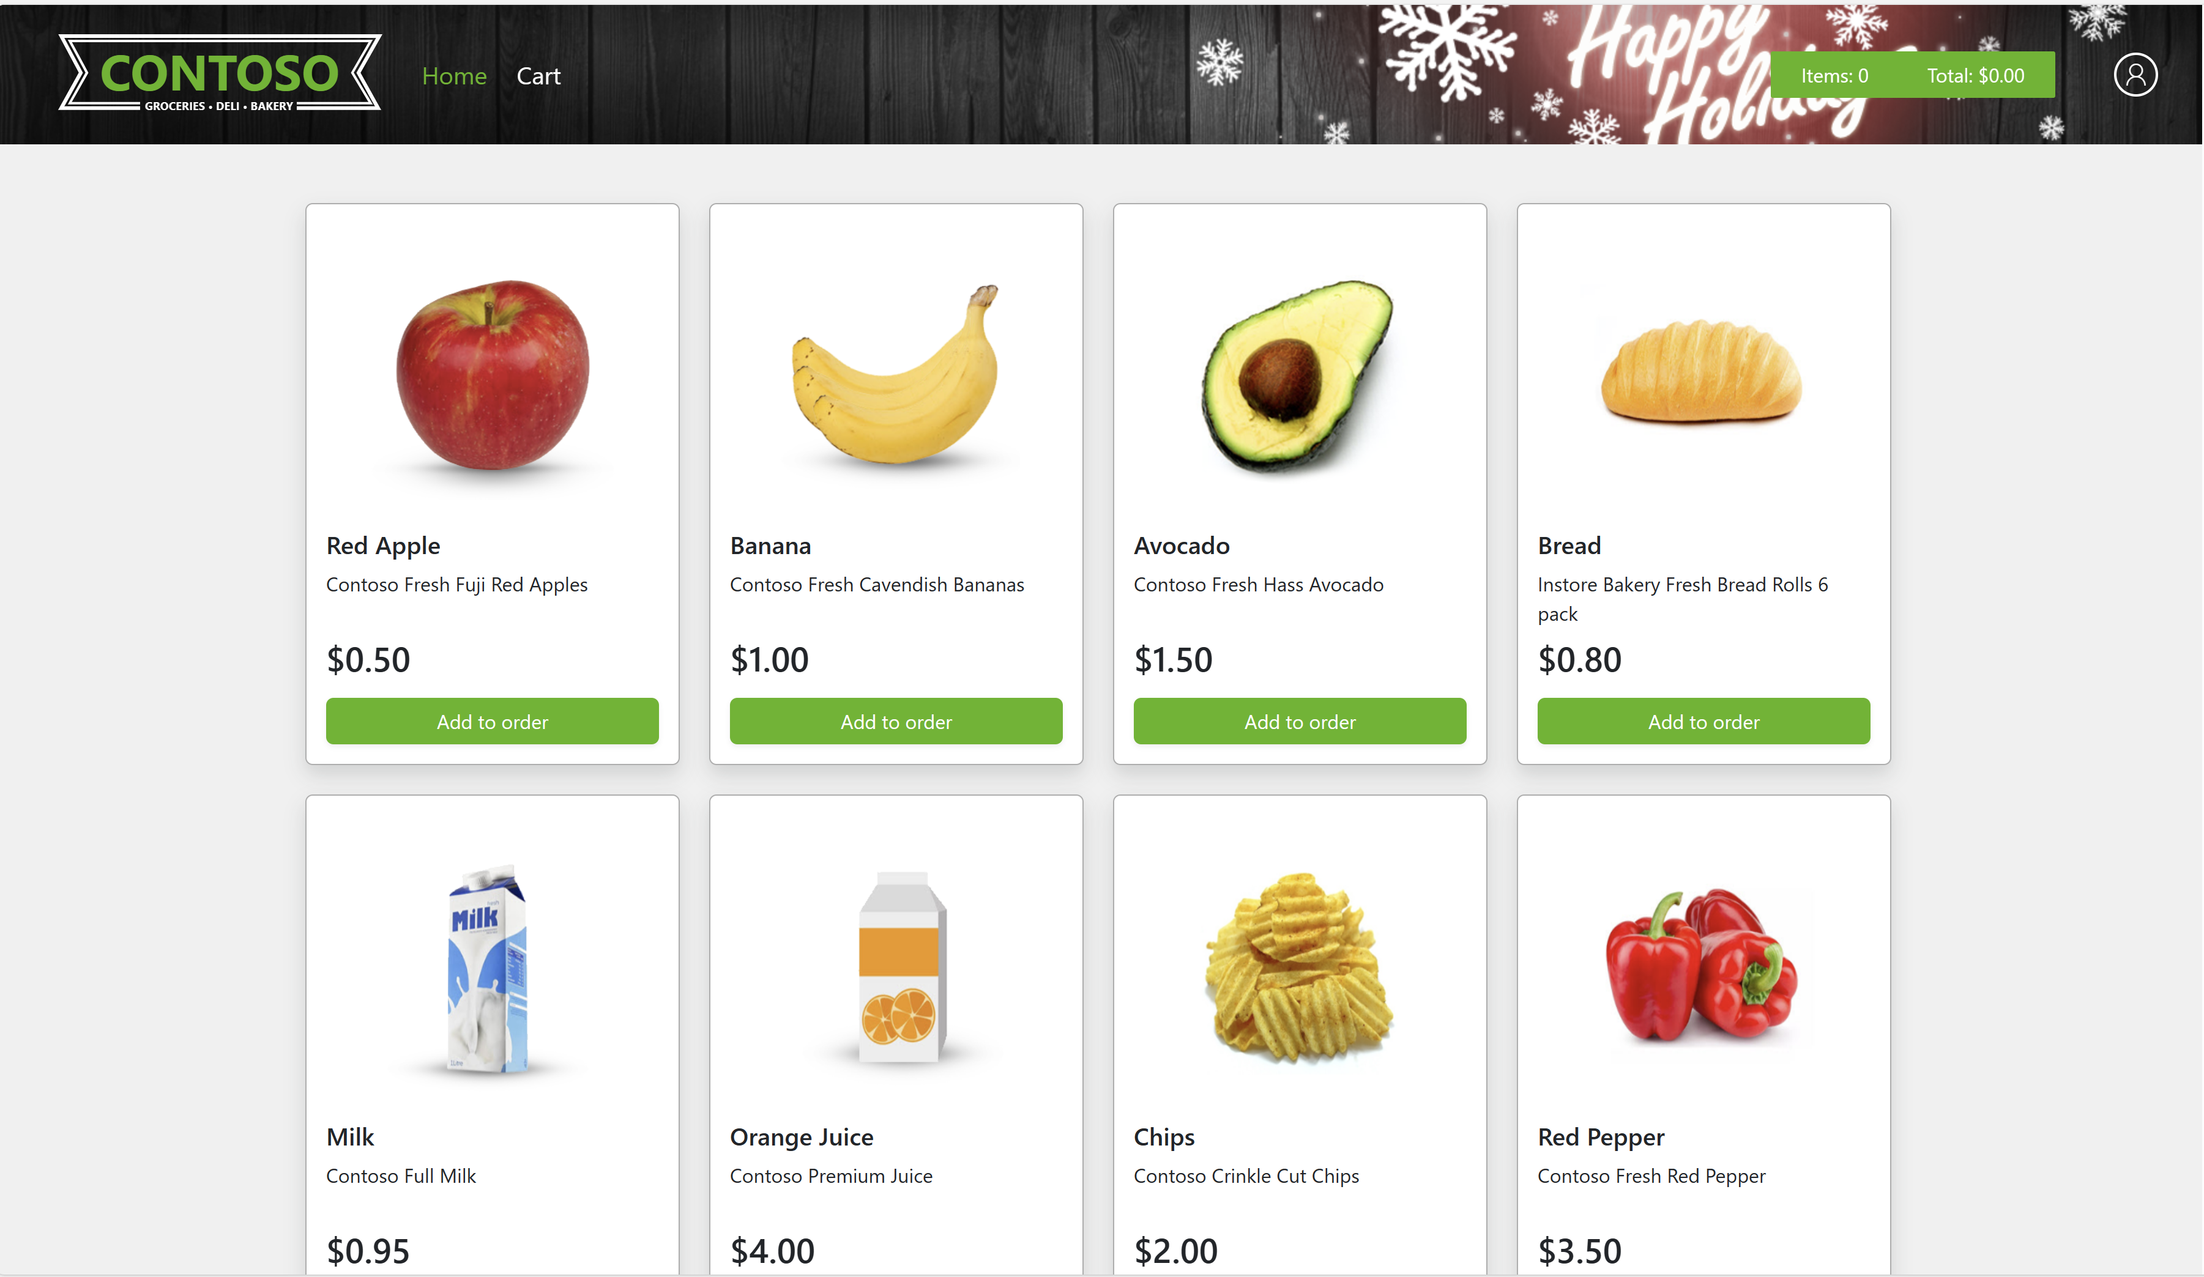
Contoso Supermarket – Point of Sale (PoS) service shopper view

Slide 35
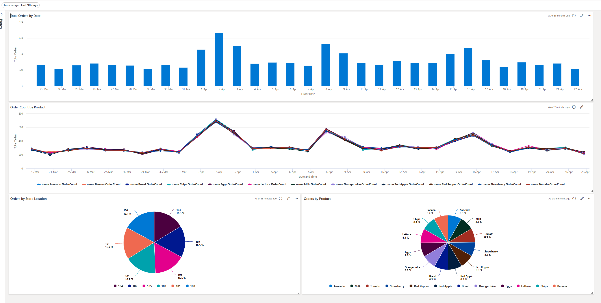
Contoso Supermarket – Data-driven dashboards

Slide 36
Contoso Supermarket – Queue Monitoring service store manager checkout queue management

Slide 37
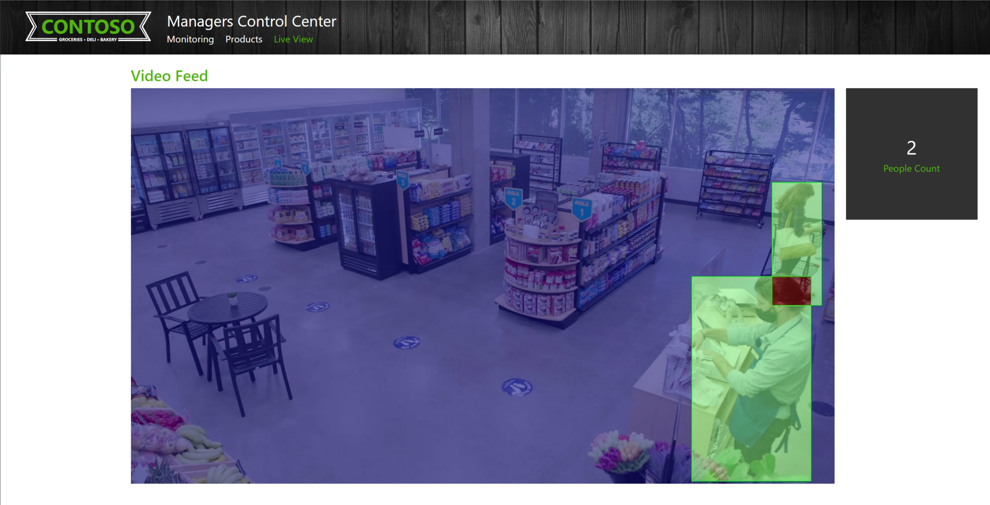
Contoso Supermarket – Queue Store manager video monitoring

Slide 38

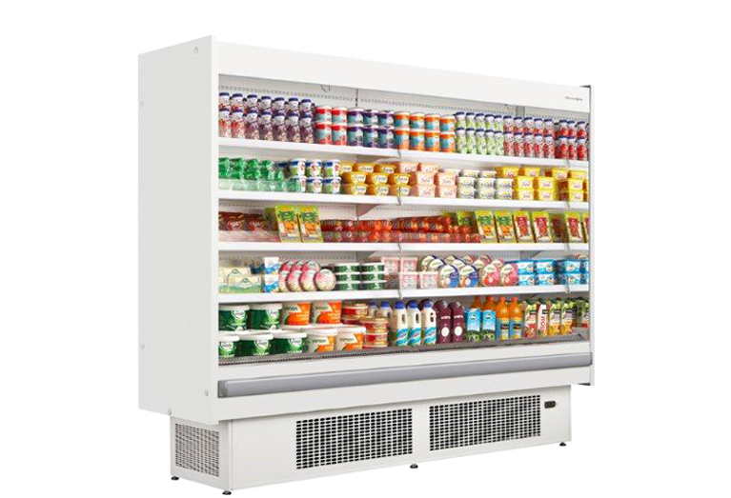
Contoso Supermarket – Freezer Monitoring for Food Safety service architecture
MQTT publisher streams temperature change messages to the MQTT broker
Parrel steps:
MQTT broker streams temperature change messages to the observability stack
MQTT broker streams temperature change messages to the IoT Hub
Temperature change messages are ingested into an Azure Data Explorer database
Temperature change events are visualized using Grafana or Azure Data Explorer Web UI
Azure Data Explorer (ADX)
Azure IoT Hub (MQTT Subscriber)
ADX Dashboards
MQTT: {"Temperature (F)": 2},
{"Humidity (%)": 43}
4
3
2B
MQTT: {"Temperature (F)": 2},
{"Humidity (%)": 43}
Store AKS Edge Essentials cluster (Arc-enabled)
Store Freezer integrated
MQTT client (Publisher)
Mosquitto MQTT Broker
Observability stack
MQTT: {"Temperature (F)": 2},
{"Humidity (%)": 43}
MQTT: {"Temperature (F)": 2},
{"Humidity (%)": 43}
1
2A
Prometheus
Grafana

Slide 39
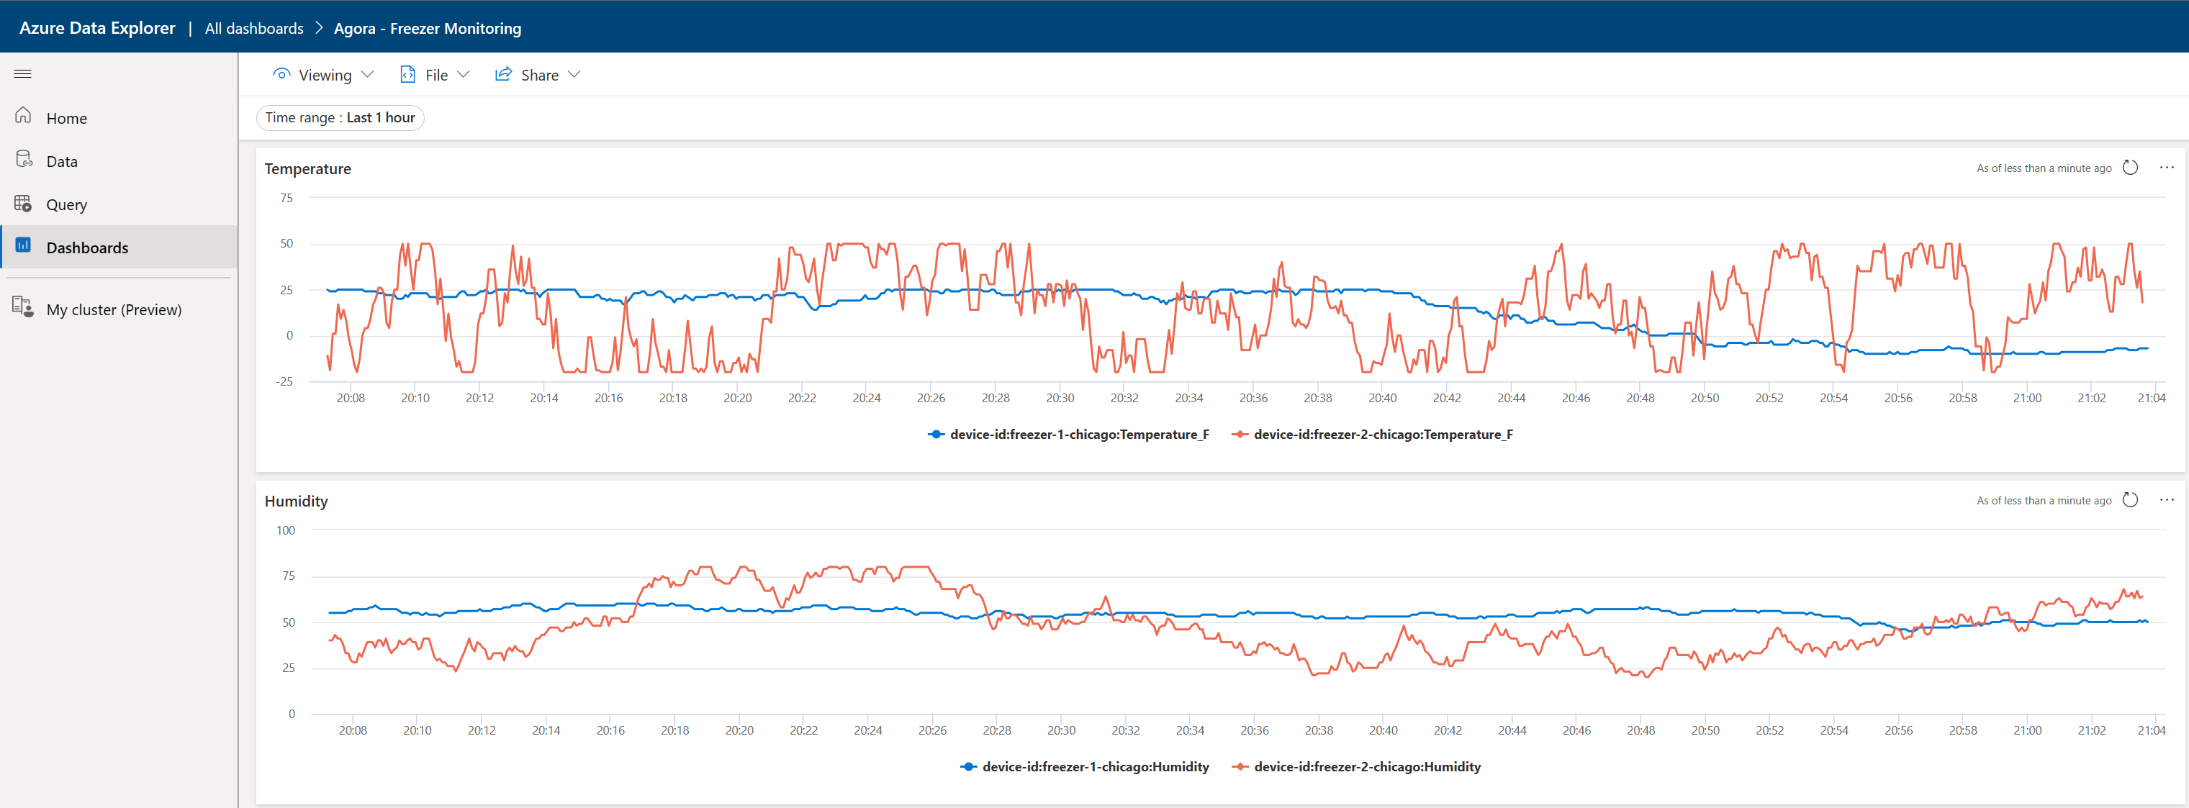
Contoso Supermarket – Freezer Monitoring for Food Safety service store manager view (Azure Data Explorer)

Slide 40
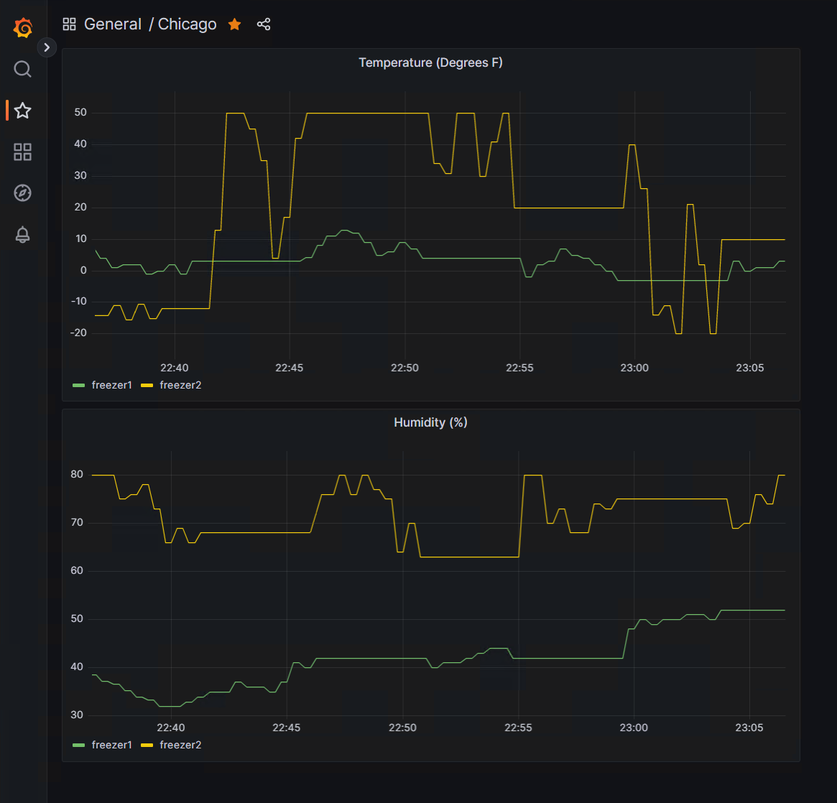
Contoso Supermarket – Freezer Monitoring for Food Safety service Operator view (Grafana)

Slide 41


Contoso Supermarket – AKS Edge Essentials L0-1-2 virtualization stack architecture
Seattle AKS EE cluster
Chicago AKS EE cluster
Local Dev AKS EE cluster
CBT Mariner Linux
L2 Hyper-V virtual machine deployed as nested VM by the AKS EE cluster as a Kubernetes control-plane node
CBT Mariner Linux
L2 Hyper-V virtual machine deployed as nested VM by the AKS EE cluster as a Kubernetes control-plane node
CBT Mariner Linux
L2 Hyper-V virtual machine deployed as nested VM by the AKS EE cluster as a Kubernetes control-plane node
L2 VM
L2 VM
L2 VM
Seattle W11-IoT VM
Windows 11 IoT L1 Hyper-V virtual machine deployed as nested VM on the L0 VM and Hyper-V role and nested virtualization enabled by itself
Chicago W11-IoT VM
Windows 11 IoT L1 Hyper-V virtual machine deployed as nested VM on the L0 VM and Hyper-V role and nested virtualization enabled by itself
Local Dev W11-IoT VM
Windows 11 IoT L1 Hyper-V virtual machine deployed as nested VM on the L0 VM and Hyper-V role and nested virtualization enabled by itself
L1 VM
L1 VM
L1 VM
Windows Server 2022 Client VM (deployed in Azure, nested virtualization enabled)
L0 VM

Slide 42
Contoso Supermarket – Development and deployment cycle environment mapping
Inner Loop
Outer Loop
Code
Test
Debug
Code
Build
Deploy
Debug
Integrate
Test
Deploy
Release
Continues Delivery via GitOps (Production)
Local Development
Build
Continues Integration
Push
Push
Continues Delivery via GitOps (Canary/Staging)
Arc-enabled Local Dev AKS Edge Essentials
Staging AKS
Arc-enabled Chicago Canary AKS Edge Essentials
Arc-enabled Seattle Production AKS Edge Essentials

Slide 43














Contoso Supermarket – CI/CD workflow
Developer makes code change in VSCode devContainer, check-in code to remote fork feature branch, test, and debug in Dev Kubernetes cluster.
Upon successful testing and debug, developer will submit a pull request (PR) against base branch.
Once PR is approved, feature branch is merged to base branch.
Continues Integration (CI) workflow starts
GitHub Action CI workflow starts and runs unit tests, and container image building
Once completed, new image version with stage-v1.x tag is pushed to ACR.
Continues Integration (CI) workflow end and Continues Delivery (CD) workflow starts
GitHub Actions workflow creates a PR to update the Helm manifest which holds the Staging GitOps configuration. PR is auto approved via the workflow.
Flux operator capture the new commit in staging branch, pull the stage-v1.x image from ACR and deploy to staging cluster.
Upon deployment, flux notification controller trigger GitHub Action workflow for staging integration tests in Staging. 9Err. If staging Integration tests fail, return to developer.
Upon Integration tests completion, GitHub Actions workflow push new canary-v1.x image to ACR.
Once canary-v1.x image pushed to ACR, DevOps engineer creates a PR against canary branch to update the Helm manifest which holds the Canary GitOps configuration.
PR is manually approved by release manager.
Flux operator capture the new commit in canary branch, pull the canary-v1.x image from ACR and deploy to canary cluster.
Upon deployment, flux notification controller trigger GitHub Action workflow for canary testing. 14Err. If canary tests fail, return to Release Manager for further investigation.
Upon canary tests completion, GitHub Actions workflow push new prod-v1.x image to ACR.
Once prod-v1.x image pushed to ACR, DevOps engineer creates a PR against production branch to update the Helm manifest which holds the Production GitOps configuration.
PR is manually approved by release manager.
Flux operator capture the new commit in production branch, pull the prod-v1.x image from ACR and deploy to production cluster.
Upon deployment, flux notification controller trigger GitHub Action workflow for production testing. 19Err. If production tests fail, return to Release Manager for further investigation.
Upon production tests completion, GitHub Actions workflow push new latest image to ACR.
Continues Delivery (CD) workflow ends
Dev cluster (AKS-EE)
stage-v1.x image
5
Code check-in
Test & Debug
1
4
Azure Container Registry (ACR)
Base branch
GitHub Actions
Client VM
2
Pull request
VSCode
devContainer
3
Auto approved PR
6
Source code
PR merged
Staging branch
Developer
9
Err
7
Helm manifest
Holding GitOps environment variables
HTTPS request
9
Staging cluster (AKS)
GitHub Actions
canary-v1.x image
8
14
Integration tests
12
prod-v1.x image
10
Pull request
PR merged
11
HTTPS request
Canary branch
Canary cluster (AKS-EE, Arc-enabled)
GitHub Actions
Helm manifest
Holding GitOps environment variables
13
DevOps
15
16
Release Manager
Canary tests
Pull request
PR merged
14
Err
19
latest image
Production branch
HTTPS request
19
Err
Production cluster (AKS-EE, Arc-enabled)
GitHub Actions
Helm manifest
Holding GitOps environment variables
18
17
Production tests

Slide 44
Contoso Supermarket – Observability infrastructure stack architecture
AKS Edge Essentials Local Development cluster
AKS Edge Essentials Seattle Production cluster
AKS Edge Essentials Chicago Production cluster
Staging Prometheus
Staging Grafana
Production Prometheus
Staging Production
AKS Staging cluster
Local Dev W11-IoT VM
Seattle W11-IoT VM
Chicago W11-IoT VM
L1 VM
L1 VM
L1 VM
Staging Prometheus
Staging Grafana
Production Grafana
Windows Server 2022 Client VM (deployed in Azure, nested virtualization enabled)
L0 VM
Azure

Slide 45
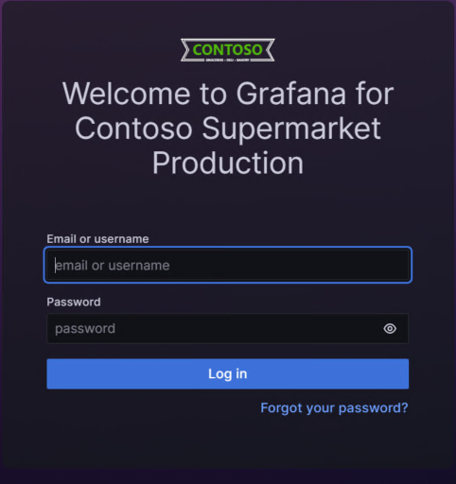
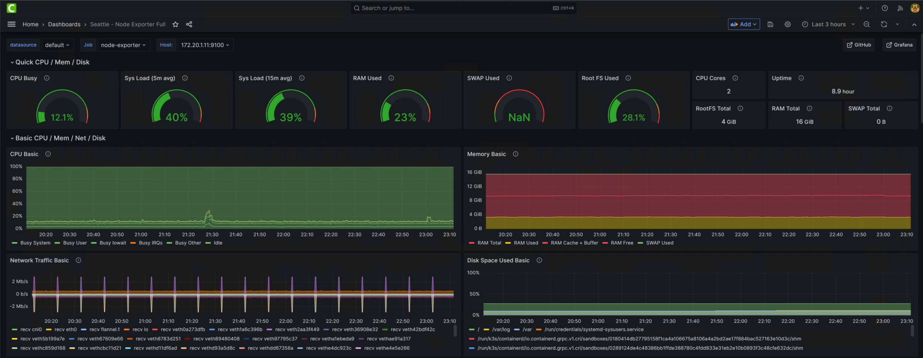
Contoso Supermarket – Kubernetes operational infrastructure observability

Slide 46


Contoso Supermarket – Deployment workflow
5
Azure resources deployment
1
Jumpstart user
Client VM
3
4
Azure CLI
“Bootstrap” PowerShell script runtime via Custom Script Extension
“Bootstrap” PowerShell script inject the “Logon” PowerShell script to the Client VM
2
Bicep template
6
Logon script runtime
User uses either Azure CLI to deploy a single Azure Bicep template.
Template deploys multiple Azure resource, including the Client virtual machine.
Client VM is using Custom Script Extension to run the Bootstrap PowerShell script, responsible from initial environment bootstrap and preparation.
Bootstrap PowerShell script inject the “Logon” PowerShell script to Client VM.
User log in to Client VM via RDP or Azure Bastion, which automatically start the “Logon” PowerShell script.
“Logon” PowerShell script runtime perform multiple additional automated operations to prepare the rest of the environment.
Environment automation preparations
Agora Apps GitHub repository
preparations
Creating Azure IoT resources
Configuring nested virtualization infrastructure for AKS Edge Essentials
Configuring GitOps and deploying applications
Azure Arc integration and extensions config
Additional Kubernetes configurations
Deploying AKS Edge Essentials
Deploying observability stack
Installing dev tools
Additional environment preparations
Logging and cleanup

Slide 47

Arc Jumpstart – Contoso Motors

Slide 48
Arc Jumpstart – Contoso Motors scenarios
Scenario | Service / Platform | Technology stack
Data pipeline and reporting across cloud and edge | Operational technology (OT) | Azure IoT Operations, Azure Data Explorer, MQTT, Event Grid, Event Hub, Rancher K3s, InfluxDB, MQTT simulators
Web UI and AI Inference | Operational technology (OT) | OpenVINO™ Open Model Zoo,Yolo8, OpenVINO™ Model Server (OVMS), Rancher K3s, RTSP, Flask, OpenCV
Welding defect scenario using OpenVINO™ and Kubernetes | Welding monitoring | RTSP simulator, OpenVINO™ Model Server (OVMS), Rancher K3s, Flask, OpenCV
Enabling AI at the edge to enhance workers safety | Workers safety | RTSP simulator, OpenVINO™ Model Server (OVMS), Rancher K3s, Flask, OpenCV
Infrastructure observability for Kubernetes and Arc-enabled Kubernetes | Infrastructure | Arc-enabled Kubernetes, Rancher K3s, Prometheus, Grafana

Slide 49






Contoso Motors technology stack
Tools and operations
Contoso Motors AI and applications stack
Welding
Pose estimation
Helmet detection
Object detection
Defect detection
Azure Policy
Azure Log Analytics
Prometheus and Grafana observability stack
Secrets
IDE
Rancher K3s Arc-enabled Kubernetes
Key Vault
Azure Monitor
Simulators
GitOps
Azure IoT Operations
InfluxDB
Dashboards
Azure Data Explorer (ADX)
Cost management
Client interfaces
Azure Event Hubs
Azure Event Grid
Azure Compute, storage and network stack

Slide 50
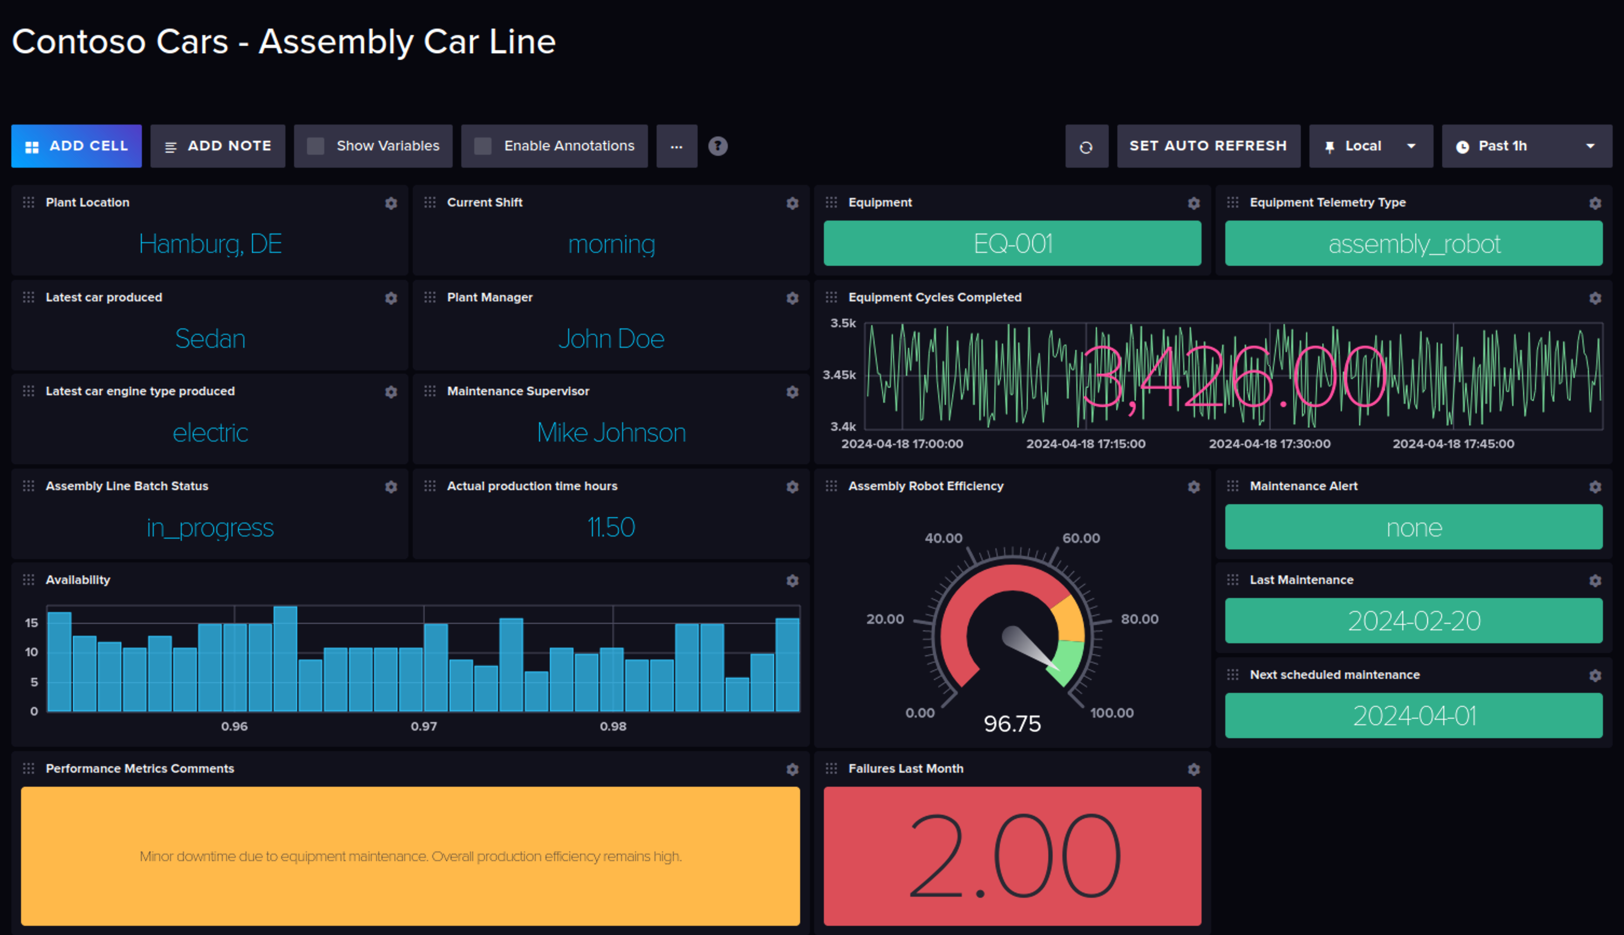

Contoso Motors – Edge Data & AI architecture
Azure IoT Operations deployed on a Rancher K3s Arc-enabled Kubernetes cluster with MQTT and OPC broker services
OVMS deployed on the cluster and pre-loaded with sample models
Human pose detection
Welding
Defect detection
Object detection
RTSP feed via available in-client application (with simulated RTSP feed)
RTSP feed use real RTSP feed (or use Jumpstart simulated feed) running on the cluster
OVMS creates API service using the desired pre-loaded model
Simulated MQTT and OPC data sent to brokers
Data pipeline from edge to cloud via Northbound connectors to Event Grid
Event Hub received data from Event Grid for additional reporting and dashboards in ADX
Event Hub
Azure Data Explorer (ADX)
8
ADX Dashboards
Event Grid
7
Factory floor-located, Rancher K3s Arc-enabled Kubernetes cluster
Grafana and InfluxDB IT/OT observability and monitoring dashboards
5
video-to-frame decoder client web application
Inferencing Model API service
Simulation stack
Azure IoT Operations
1
Data Analyst / AI models admin
MQTT Listener
Northbound Connector
3
OpenVINO™ Model Server (OVMS)
RTSP feed
RTSP simulator
MQTT Simulator
MQTT Broker
Model library with pre-loaded models
6
4
OPC Simulator
OPC UA Broker
2
InfluxDB

Slide 51
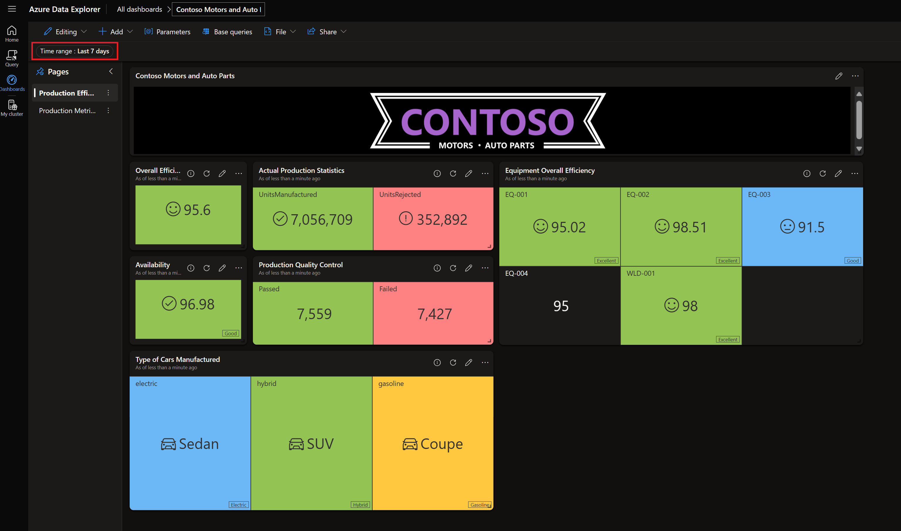
Contoso Motors – Data pipeline architecture
Azure Data Explorer (ADX)
5
ADX Dashboards
6
7
Event Grid
Event Hub
4
Management
OT Frontline workers
8
Grafana and InfluxDB IT/OT observability and monitoring dashboards
Grafana and InfluxDB IT/OT observability and monitoring dashboards
Simulated MQTT and OPC UA data sent to brokers
Azure IoT Operations MQ relays messages to the pre-build Northbound Connector.
Northbound Connector publishes messages to Azure Event Grid using MQTT v5.
Event Hub receives data from Event Grid for additional reporting and dashboards in ADX.
ADX data connector receives messages from Event Hub and stores in the manufacturing database for real-time analytics and dashboard reports.
Contoso Motors corporate management roles access ADX dashboards reports.
ADX Dashboards connects to ADX database and renders reports with real-time data.
Contoso Motors OT Frontline workers can use dashboards in the edge to gain operational insights
Factory floor-located, Rancher K3s Arc-enabled Kubernetes cluster, Detroit, US
Factory floor-located, Rancher K3s Arc-enabled Kubernetes cluster, Monterrey, MX
Simulation stack
Azure IoT Operations
MQTT Listener
Northbound Connector
3
3
Replica site
MQTT Simulator
MQTT Broker
2
1
OPC Simulator
OPC UA Broker

Slide 52






Contoso Motors – Edge AI inference flow
“Model Downloader” download the required model for the inferencing scenario
Human pose detection
Welding
Defect detection
Object detection
“Video Downloader” download the required video feeds to simulate the RTSP steams.
Use OpenCV and Flask to capture the video stream from the RTSP streams.
Run the appropriate model frame preprocessing and send the frame for inferencing to OVMS using gRPC.
Using the inferencing response, apply the appropriate model postprocessing and serve the final frame to the Flask UI.
Models
Storage Account
Videos
Storage Account
1
2
Factory floor-located, Rancher K3s Arc-enabled Kubernetes cluster
4
Web AI
Inferencing & UI
Inferencing Model API service
Model Downloader
RTSP simulator
5
Post-process and UI rendering
OpenVINO™ Model
Server (OVMS)
Model library with pre-loaded models
ovms-pvc
Video Downloader (Init-Container)
Pre-process and AI Inference
Data Analyst or AI models admin
3
Video Streamer Capture
CPU/GPU/TPU
RTSP feed
RTSP Video Services
tmp-samples

Slide 53
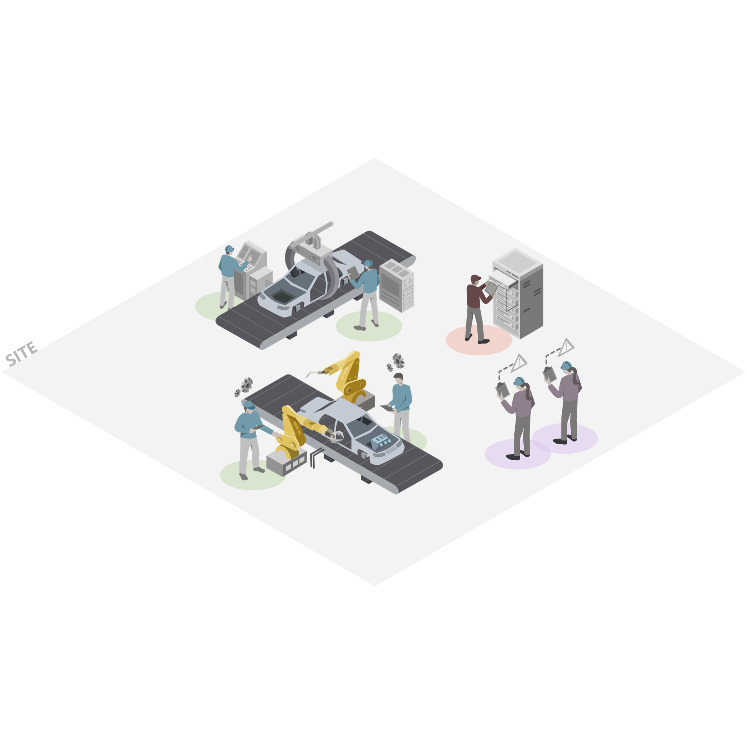


Contoso Motors – Welding Defect flow
User clicks on the Site UI and then selects the Welding Defect station.
RTSP video feed simulates welding station using the RTSP simulator.
Using OpenCV, capture the video frames from the RTSP feed and handle each frame for the AI inference.
Frame is pre-processed following the Model specification, torch is created and sent to the AI Inference server using gRPC.
The OVMS sends a response with the AI inference result. The result is used for the frame post-processing and final serve to the UI with labels/drawings applied.
Factory floor-located, Rancher K3s Arc-enabled Kubernetes cluster
RTSP feed
RTSP Video Services
OpenVINO™ Model
Server (OVMS)
RTSP simulator
Model library
5
4
2
3
Web AI Inferencing & UI
Video Streamer Capture
Pre-process and AI Inference
Post-process and UI rendering
1
Re-Shape
Convert to Tensor
gRPC AI Call
90% Porosity
Site user

Slide 54
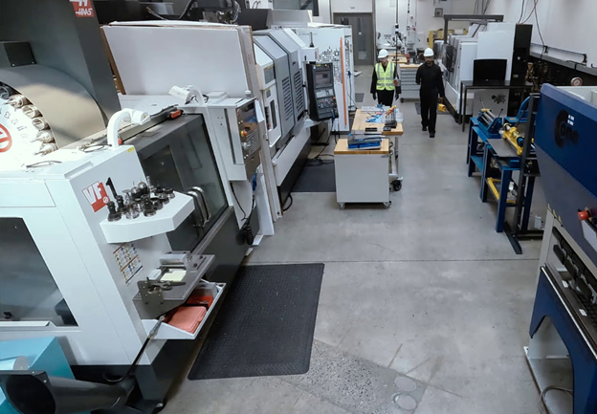
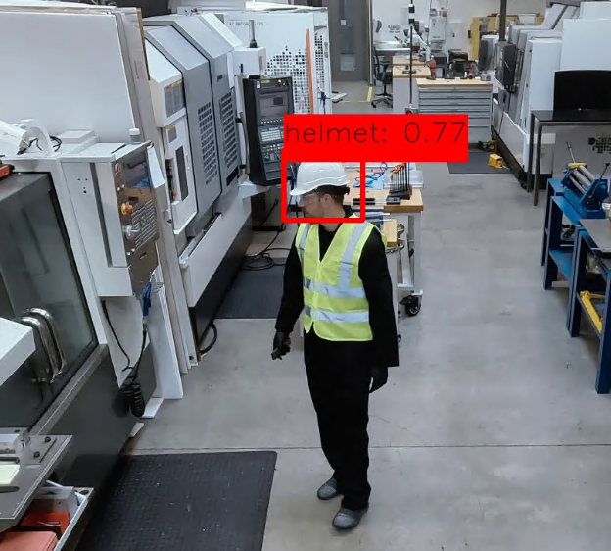
Contoso Motors – Worker Safety flow
User clicks on the Site UI and then selects the Worker Safety station.
RTSP video feed simulates worker at station using the RTSP simulator.
Using OpenCV, capture the video frames from the RTSP feed and handle each frame for the AI inference.
Frame is pre-processed following the Model specification, torch is created and sent to the AI Inference server using gRPC.
The OVMS sends a response with the AI inference result. The result is used for the frame post-processing and final serve to the UI with labels/drawings applied.
Factory floor-located, Rancher K3s Arc-enabled Kubernetes cluster
RTSP feed
RTSP Video Services
OpenVINO™ Model
Server (OVMS)
RTSP simulator
Model library
5
4
2
3
Web AI Inferencing & UI
Video Streamer Capture
Pre-process and AI Inference
Post-process and UI rendering
Re-Shape
Convert to Tensor
gRPC AI Call
0.77 Precision
Site User
1

Slide 55
Contoso Motors – Kubernetes observability architecture
Rancher K3s Arc-enabled Kubernetes Detroit cluster
Rancher K3s Arc-enabled Kubernetes Monterrey cluster
Prometheus
Prometheus
3 x Detroit Ubuntu Azure VM
3 x Monterrey Ubuntu Azure VM
Windows Server 2022 Azure Client VM
Production Grafana (Windows MSI Web Client)
Azure

Slide 56
Contoso Motors – Deployment workflow
5
Azure resources deployment
1
Jumpstart user
Client VM
3
4
Azure CLI
“Bootstrap” PowerShell script runtime via Custom Script Extension
“Bootstrap” PowerShell script inject the “Logon” PowerShell script to the Client VM
2
Bicep template
6
Logon script runtime
User uses Azure CLI to deploy a single Azure Bicep template.
Template deploys multiple Azure resource, including the Client virtual machine.
Client VM is using Custom Script Extension to run the Bootstrap PowerShell script, responsible from initial environment bootstrap and preparation.
Bootstrap PowerShell script inject the “Logon” PowerShell script to Client VM.
User log in to Client VM via RDP or Azure Bastion, which automatically start the “Logon” PowerShell script.
“Logon” PowerShell script runtime perform multiple additional automated operations to prepare the rest of the environment.
Environment automation preparations
Configuring Azure infrastructure for Rancher K3s cluster
Deploying Rancher K3s cluster
Additional Kubernetes configurations
Configuring GitOps and deploying applications
Configuring data pipeline from Edge to Cloud
Deploying Azure IoT Operations
Azure Arc integration and extensions config
Deploying observability stack
Installing dev tools
Additional environment preparations
Logging and cleanup

Slide 57

Arc Jumpstart – Contoso Hypermarket

Slide 58
Arc Jumpstart – Contoso Hypermarket scenarios
Scenario | Technology stack
Shopper insights using computer vision | Yolo8, RTSP, OpenCV, Rancher K3s, PostgreSQL, Azure Arc
Jumpstart Cerebral - Commercial and Operations assistance with Gen AI | Azure OpenAI, phi3, gpt35turbo, Rancher K3s, InfluxDB, Microsoft SQL Server on Linux
Commercial and operations assistance with Speech-to-Text | Azure AI Speech, Rancher K3s, Azure Arc
Industrial assets observability | Prometheus, Grafana
Shopper insights observability | Prometheus, Grafana
Kubernetes infrastructure observability | Arc-enabled Kubernetes, Rancher K3s, Prometheus, Grafana
Data pipeline and reporting for operational technology (OT) | Azure IoT Operations, Microsoft Fabric, MQTT, Event Hub, Rancher K3s, InfluxDB, PostgreSQL, MQTT simulators
Data pipeline and reporting for commercial sales | Azure IoT Operations, Microsoft Fabric, MQTT, Event Hub, Rancher K3s, InfluxDB, PostgreSQL, MQTT simulators
Predictive analytics using Microsoft 365 Copilot | Microsoft 365 Copilot

Slide 59















Contoso Hypermarket – Technology stack and operations overview
Footfall, Shopper insights, Gen AI Commercial and Operations assistance, Speech-to-Text (STT) operations, Edge-to-cloud video analytics, Predictive inventory and operations analytics
Local infrastructure
Azure infrastructure
Security and operations
Data and IoT
AI and Computer Vision
Dev and CI/CD operations
Assets
Azure compute, storage and network
Azure Monitor
Microsoft Fabric
Jumpstart Cerebral
Visual Studio Code
Azure Policy
Azure IoT Operations
Microsoft Copilot
GitHub repositories
Kubernetes
Azure Key Vault
Azure Event Hub
Azure OpenAI
GitOps
Ubuntu and Rancher K3s
Microsoft Defender for Cloud and Containers
SQL Server on Linux
Azure AI Speech
Data simulators
Arc-enabled Kubernetes
PostgreSQL
Generative AI models
Azure Data Studio
Azure Container Registry
Prometheus and Grafana observability stack
InfluxDB
Computer Vision models
Arc-enabled servers
Cost management and billing
Azure Container Storage enabled by Azure Arc

Slide 60


Contoso Hypermarket – Deployment workflow
Rancher K3s two-node cluster
Rancher K3s two-node cluster
Azure OpenAI
Microsoft Fabric
Azure VM x 2
Azure VM x 2
Azure Bastion
Jumpstart Client Azure VM
1
Azure CLI
5
“Bootstrap” PowerShell script runtime via Custom Script Extension
“Bootstrap” PowerShell script inject the “Logon” PowerShell script to Client VM
Jumpstart user
4
Azure Bicep template
2
3
6
“Logon” runtime script
Jumpstart user deploy a single Azure Bicep template via Azure CLI.
Template deploys multiple Azure resource, including the Jumpstart Client virtual machine, two K3s clusters, Microsoft Fabric Capacity, and an Azure Open AI instance.
Client VM is using Custom Script Extension to run the “Bootstrap” PowerShell script, responsible for initial environment bootstrap and preparation.
Bootstrap PowerShell script inject the “Logon” PowerShell script to Client VM.
User log in to Client VM via RDP or Azure Bastion, which automatically start the “Logon” PowerShell script OR script runs automatically if user set vmAutologon bicep parameter to true.
“Logon” PowerShell script runtime perform multiple additional automated operations to prepare the rest of the environment.
Environment automation preparations
K3s cluster configurations
Azure Arc integration and extensions config
Configuring GitOps and deploying applications
Configuring data pipeline from edge to cloud
Deploying Azure IoT Operations
Deploying observability stack
Installing dev tools
Additional environment preparations
Logging and cleanup

Slide 61


Contoso Hypermarket – Real-time footfall inferencing and shopper insights architecture
RTSP video feed captures real-time pedestrian traffic.
Video frame extracted from video and sent to video processor for inferencing using Python OpenCV.
Video processor retrieves custom bounding box for area to be analyzed from middleware API.
The model creates an AI inference response with the result available via API call.
Application takes result and publishes MQ message in Azure IoT Operation.
Application user interface updates and shows frame with inferencing annotations added.
Azure IoT Operations Dataflows connects to MQTT Broker, and relays MQ messaging data to Azure Event Hub.
KQL DB, deployed in Microsoft Fabric, pull and ingest data from Azure Event Hub.
Microsoft Fabric
8
Event Hub
7
Edge-located Arc-enabled Kubernetes cluster
Footfall AI Inferencing API
Azure IoT Operations
4
Video Capture
Video Processor
2
Dataflow
5
RTSP feed
MQTT Broker
3
Main UI and middleware API
1
6
Main UI
Backend API
PostgreSQL database (Camera metadata)

Slide 62




Contoso Hypermarket – Application architecture
Store Manager
Logistics Manager
Operations Manager
Edge-located Arc-enabled Kubernetes cluster
Contoso Hypermarket web user interface (React JS web application)
Azure AI Services
Azure AI Speech
Cerebral queries results
Simulated data populated directly in various web app interfaces
Video and inferencing results
Query local store camera and zone data
RAG-based queries
Jumpstart Cerebral APIs
Computer Vision APIs
Backend API (Flask Python)
Azure OpenAI
Jumpstart Cerebral API
Query processing
Jumpstart Cerebral
Data Simulator
Footfall API
Speech-to-Text API
Stored local store camera and zone data
RAG-based queries
Simulated data stored in databases
Shopper Insights API
Backend PostgreSQL database
chroma vector database
Supported databases and Bring-your-own DB
Language model “Microsoft Phi-3 Mini-4K”
RTSP feed
Read RTSP feed and process frame

Slide 63




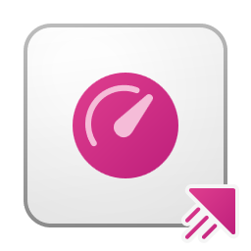
Jumpstart Cerebral – Solution overview architecture
Store Manager
Logistics Manager
Operations Manager
Chatbot / speech-to-text / notifications
Edge-located Arc-enabled Kubernetes cluster
Azure AI Services
Proactive recommendation and alerts engine
React JS web application
Azure AI Speech
GET API call
Speech-to-Text (STT)
Query classification and data contextualization
Azure OpenAI
REST API Query processing orchestrator
RAG-based queries
Azure IoT Operations
Database connectors
chroma vector database
Dataflow
Microsoft Fabric
Language model “Microsoft Phi-3 Mini-4K”
MQTT Broker
Power BI dashboards
RAG-based queries
Real-time dashboards
Bring-your-own database solution
InfluxDB
Asset telemetry
InfluxDB
SQL Server on Linux
Relational transactions
Industrial asset telemetry data
Point-of-sale data
Data simulator
Inventory data
Contextualized industrial asset telemetry data
Dashboards data
Event Hub
Time series transactions

Slide 64
Jumpstart Cerebral – Decision tree architecture
Store Manager
Cerebral supports various industries and matching personas
Logistics Manager
Operations Manager
Cerebral common use-cases
Triggers proactive alerts based on inventory shortage, operational outages, etc.
Prepopulate work items, orders, etc.
Trigger alerts based on assets (equipment) operational state
Errors summary
Assist resolving issues using natural language
Bi-directional query workflow
Cerebral execution methods
Proactive recommendation and alerts engine “Give me the products that are low on inventory”
Natural Language queries
“Help me to troubleshooting the “Hotmelt” sensor in Fridge-2 factory line”
RAG-based query
Classification
Near real-time data
Document data
Static data
Near Real time data
The question is converted into an Influx Query Language (InfluxQL) query, which then is executed against InfluxDB to retrieve the necessary data
Relational-based data
The question is converted into a SQL query, which then is executed against SQL DB to retrieve the necessary data
General (OpenAI RAG-based query)
The query is sent to the backend at the edge, VectorDB queries are executed, and LLM vector search results are integrated with the user’s query to generate a comprehensive response

Slide 65


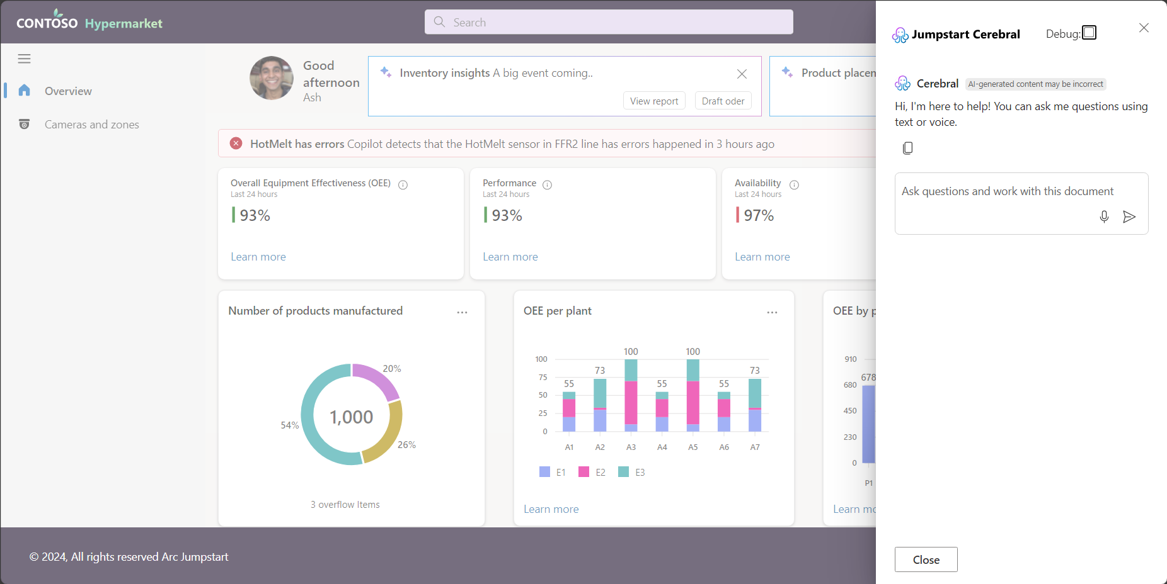




Contoso Hypermarket – Gen AI Commercial and Operations assistance via Speech-to-Text (STT)
Microphone audio feed captures user questions.
The Audio Processor function detect if there's voice and creates a blob for submitting to Jumpstart Cerebral.
The Cerebral STT connector sends the audio for transcript from speech to text.
STT function determines where to run STT – If local model available, use local model; if not use Azure AI Speech service.
Once the STT response is received, check if correct response and send it back to main Ui
Flask application renders the result of the STT in the user interface for user knowledge.
Question is sent to Cerebral, which triggers a “Process Question” event, and normal processing flow is triggered.
Azure AI Services
Azure AI Speech
4
Edge-located Arc-enabled Kubernetes cluster
4
Jumpstart Cerebral API
1
5
STT Python app
OpenAI Whisper (local)
“Record” function web component
4
1
Main user interface
Audio Processor
3
Jumpstart Cerebral REST API
(/Cerebral/API/STT)
2
Jumpstart Cerebral Web Socket (Event: Process Question)
Jumpstart Cerebral STT Connector
Contoso shopper or employe
6
Flask application
Model
persistent storage
7
Model Persistent Volume
Binary
XML

Slide 66
Contoso Hypermarket – Edge-to-cloud observability stack architecture
Azure VM
Grafana (Windows installation)
Kubernetes infrastructure Grafana dashboards
Operational assets data Grafana dashboards
Footfall RTSP stream metadata Grafana dashboards
Query metrics from Prometheus for real-time dashboard visualization
Chicago edge-located Arc-enabled Kubernetes cluster
Seattle edge-located Arc-enabled Kubernetes cluster
Prometheus
Prometheus
Industrial asset telemetry and RTSP metadata
Industrial asset telemetry and Footfall RTSP metadata

Slide 67





Contoso Hypermarket – Edge-to-cloud data pipeline architecture
Contoso shopper or employee access Web UI. Customers are placing orders while employe manage operations.
Jumpstart Cerebral is integrated in Contoso web application, designed to help users by interacting with various data sources using RAG-based (Retrieval-Augmented Generation) queries.
Cerebral APIs interacts with various data sources for various operations. All data sources being populated with relevant data using a dedicated MQTT data simulator:
SQL Server on Linux – Commercial retail data
InfluxDB – Operational and asset data telemetry
Prometheus – Operational and asset data telemetry
Grafana, deployed in Azure, query metrics from Prometheus for real-time operational and asset data telemetry for dashboard visualization.
Cerebral data simulator sends real-time operational, asset data telemetry, and commercial data to Azure IoT Operations MQTT Broker.
Cerebral data simulator sends historical commercial data directly to Azure Event Hub.
Dataflows connects to MQTT Broker, and relays operational, asset data telemetry, and commercial data into Azure Event Hub.
KQL DB, deployed in Microsoft Fabric Event House, pull and ingest data from Azure Event Hub.
Microsoft Fabric notebooks, real-time dashboards, and Power BI query KQL DB for commercial and operations data visualization.
Azure VM
Real-time Grafana dashboards
Query metrics from Prometheus for real-time dashboard visualization
4
Microsoft Fabric
Edge-located Arc-enabled Kubernetes cluster
Power BI dashboards
Contoso Hypermarket web user interface
2
Notebook
Realtime dashboards
1
3
RAG-based queries
8
Query data
8
Azure IoT Operations
SQL Server on Linux
InfluxDB
Prometheus
Event House
Dataflow
KQL DB
Simulated Point-of-sale data
Industrial asset telemetry data
Industrial asset telemetry and RTSP metadata
MQTT Broker
Contoso shopper or employe
Simulated inventory data
7
6
Relational transactions
Time series transactions
Time series transactions
Real-time operational, asset data telemetry, and commercial data
Operational, asset data telemetry, and commercial data
Pull and ingest data
Jumpstart Cerebral data simulator (real-time operational and commercial data)
Event Hub
5
Historical commercial data

Slide 68







Contoso Hypermarket – Predictive inventory and operations analytics with Generative AI
2
Prompt: “How many chocolate chip cookies did I sell each day?”
1
Generates local store sales and inventory report based on Excel spreadsheet
Local sales Excel-based report
3
RAG-based (Retrieval-Augmented Generation) queries against spreadsheet data
Contoso Sales Manager
Microsoft 365 Copilot
4
Answer: “November 21st, 2024: 45 cookies”
2
Prompt: “How much energy have I used for all of my roasts this month?”
1
Generates local energy consumption report based on Excel spreadsheet
Local energy consumption Excel-based report
3
Contoso Operations Manager
RAG-based (Retrieval-Augmented Generation) queries against spreadsheet data
4
Answer: “You have used a total of 112.09 kWh for all your roasts this month”
2
Prompt: “Which coffee stays on the store shelves the longest?”
1
Generates local coffee inventory report based on Excel spreadsheet
Local coffee inventory Excel-based report
RAG-based (Retrieval-Augmented Generation) queries against spreadsheet data
Contoso Inventory Manager
Answer: “It appears that the Nicaragua Dipilto Monte Libano beans…might stay on the store shelves the longest”
3
4

Slide 69
A curated collection of scripts, tools, and other resources from the community

Slide 70
Current challenges
Multiple teams spend significant time assisting customers, but knowledge is kept in private repositories, limiting potential benefits of community collaboration.
Contributing to Jumpstart can be challenging due to required expertise and high-quality standards.
Finding more core maintainers and contributors has become difficult due to recent changes in pre/post-sales teams.

Slide 71
What is Jumpstart Drops?
A new Jumpstart solution that serves as a curated collection of scripts, tools, and other assets that can help developers/IT/OT and Day-2 Operations professionals streamline their day-to-day operations and smooth their Adaptive cloud journey.
The term "Drops" refers to small, self-contained pieces of code that can be easily shared and leveraged by others to simplify a particular operation/task or demonstrate the power of a service/product.
It can be a dashboard, sample app, library or a package, a script or an automation, Template, and even tutorial or Guide.

Slide 72





Contribution process
Create content
Submit
Drop
Review submission
Publish Drop
Share & Get Telemetry

Slide 73
Jumpstart Drops contribution flow
Define source code hosting
Artifacts creation and uploading
Create a Pull Request (PR)
GitHub Checks
Merge to Main
Validation with Preview Site
Merge to Canary
Jumpstart team review

Slide 74
Jumpstart Drops folder structure
azuredeploy.parameters.json
templates
azuredeploy.json
_index.md
default_view.png
azure_arc_management_and_monitor_workbook
media
artifacts
Architecture_diagram.jpg
delpoy.ps1
scripts
cleanup.ps1

Slide 75
Legal & Disclaimers
Jumpstart Drops adheres to Microsoft Open-Source common practices.
Disclaimer/Legal can be summarized as follows:
All Drops are published by default under an MIT license
If no license is added as part of GitHub PR, then the PR won't be merged.
If data is included as part of the Drop, then all data should be licensed under a CDLA-2.0 license.
Microsoft is not responsible for the use of the Drops – Users must use Drops at their own risk.
Use with caution: Before applying any Drops to Production deployments, users always should test them first.

Slide 76
Submit an issue or a feature request or join our GitHub Discussions in our GitHub repository
it’s simple as that!
aka.ms/ArcJumpstart

Slide 77

Thank you

